Slide 1
MedQuarter Update to
Cedar Rapids Finance & Administrative Services Committee
3/25/21

Slide 2
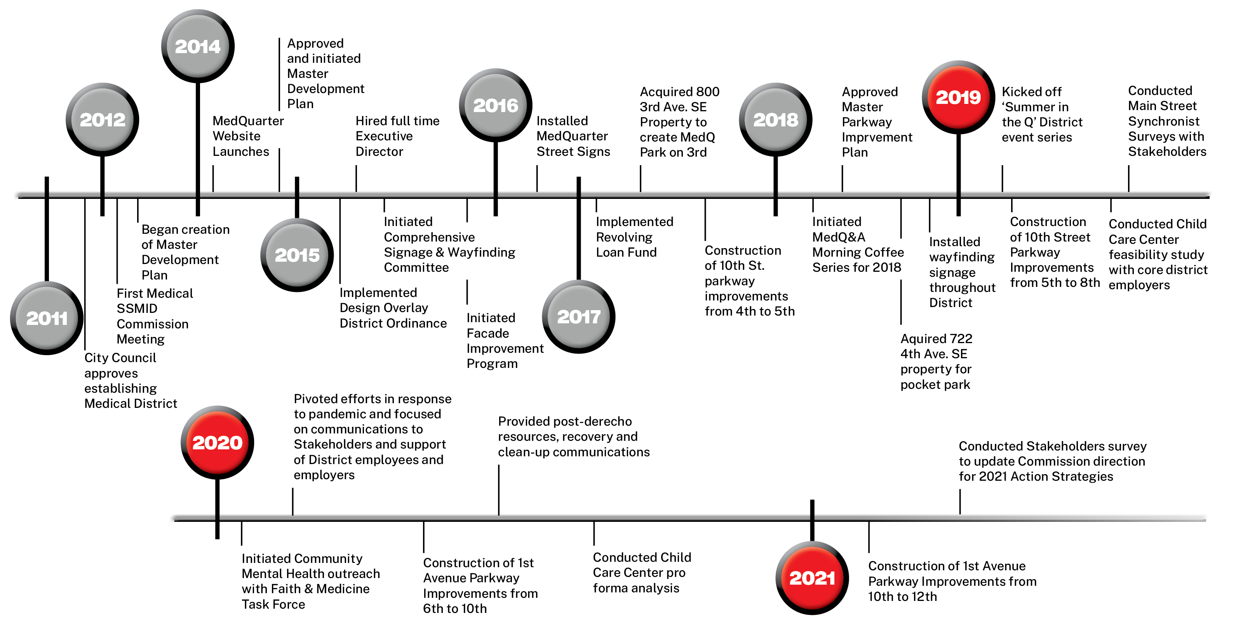
MedQuarter Historical Highlights

Slide 4
Implementation Categories from Master Development Plan
Policy
Management & Marketing
Appearance & Identity
Access, Circulation & Infrastructure

Slide 5
MedQuarter Policy Initiatives
Participation in City’s ReZone
Building Code
Initiative
Master Parkway Improvement Plan

Slide 6
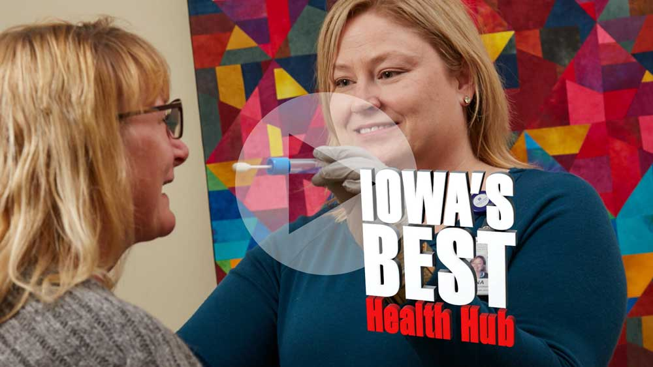
MedQuarter Management & Marketing Initiatives
MedQ Reputation
Video
MedQ
Website

Slide 7
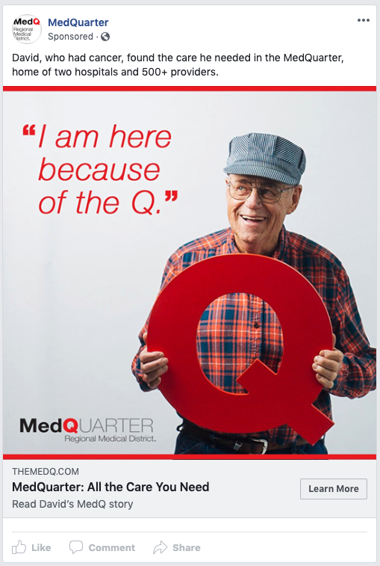
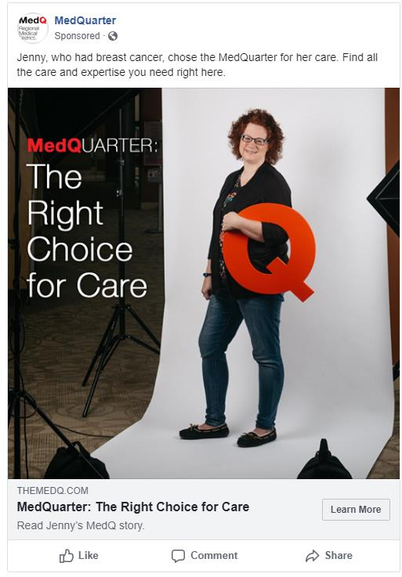
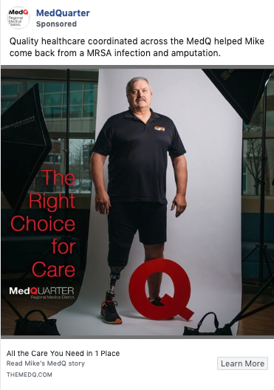
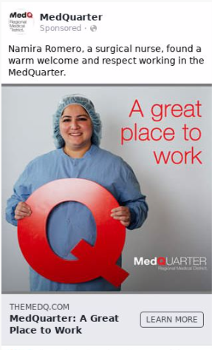
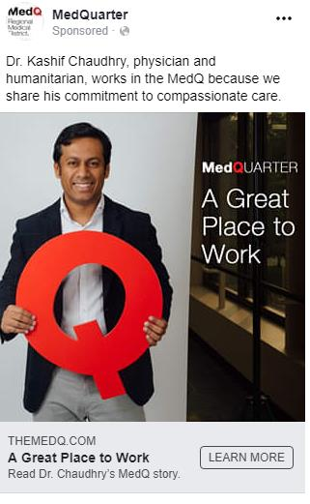
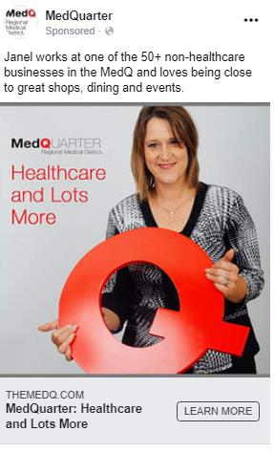
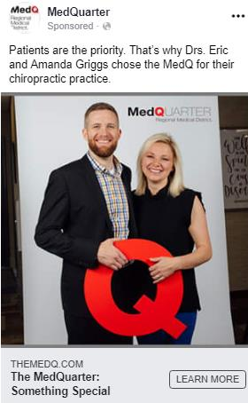
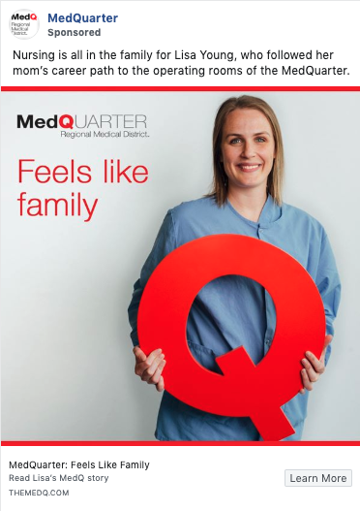
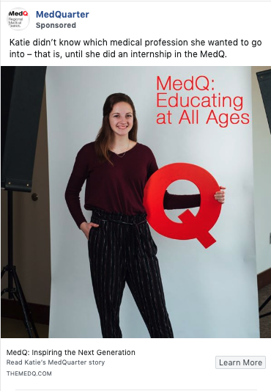
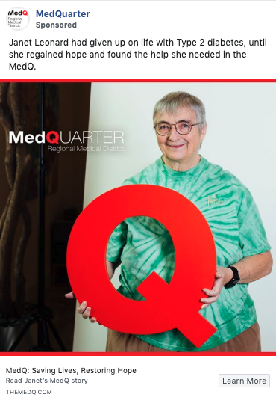
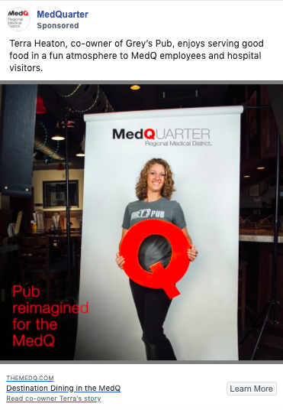
MedQuarter Management & Marketing Initiatives – ‘19/’20 People of the MedQ Campaign
790
729
902
Notes:
Slide with all 12 displayed - creating a "brand" look
Highest 3 when it comes to clicks to the website – their blog post
This would be the amount of clicks they received within the month their ad ran

Slide 8
MedQuarter Management & Marketing Initiatives – ‘19/’20 People of the MedQ Campaign
 | Goal | Where are we: April 1 2019 – May 31, 2020
Clicks to the Website | Receive 15,000 | 37,674
Website Sessions | Increase to 25,000 | 41,836
Video Views | Receive 5,000 | 32,424
Campaign ended on May 31, 2020
Notes:
Chart at the bottom and the ‘users, new users and sessions’ shows what April 1 2019 – May 31, 2020 VS April 1 2018 – May 31

Slide 9
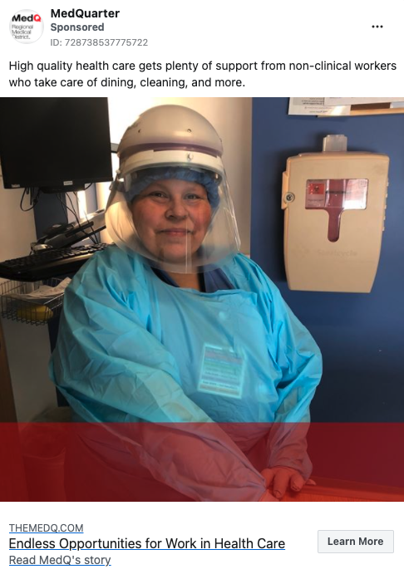
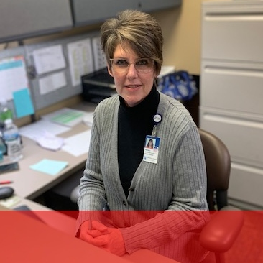
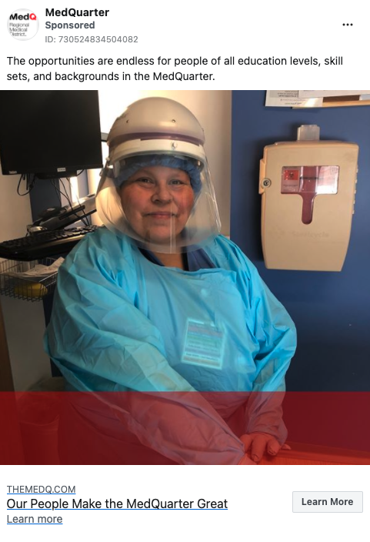
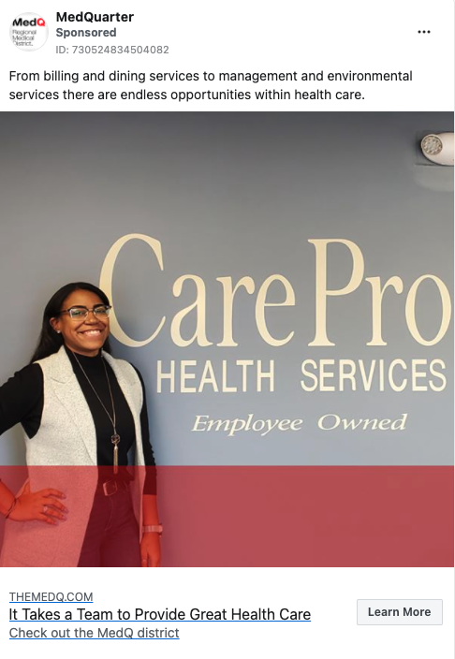
MedQuarter Management & Marketing Initiatives – ‘20/’21 Places of the MedQ Campaign
March Update for 20/21 campaign –
Launched 11/8/2020
Total Ad Impressions: 2.16 million
Website sessions: 5,535
January | Non-clinical healthcare montage
February | Firestone Complete Auto Care | Continue to Live Your Life – Don’t Delay Your Care
March | Kathy's Pie
April | Patient Story – Mercy (cardiology patient)
May | small business feature | ? - will evaluate messaging needs as we go
June | small business feature
July | Patient Story – UnityPoint (cancer patient)
Healthcare Montage
Notes:
Chart at the bottom and the ‘users, new users and sessions’ shows what April 1 2019 – May 31, 2020 VS April 1 2018 – May 31

Slide 10
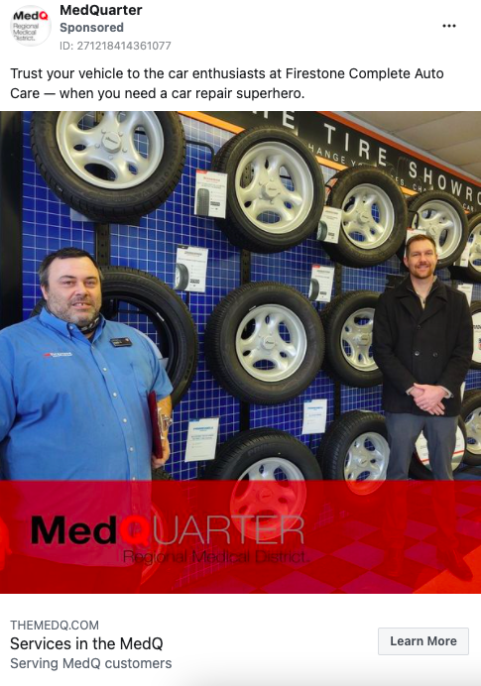
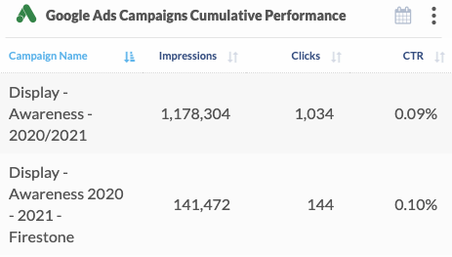
MedQuarter Management & Marketing Initiatives – ‘20/’21 Places of the MedQ Campaign
March Update for 20/21 campaign –
Launched 11/8/2020
Total Ad Impressions: 2.16 million
Website sessions: 5,535
Firestone Complete Auto Care
Notes:
Jan-Feb:

Slide 11
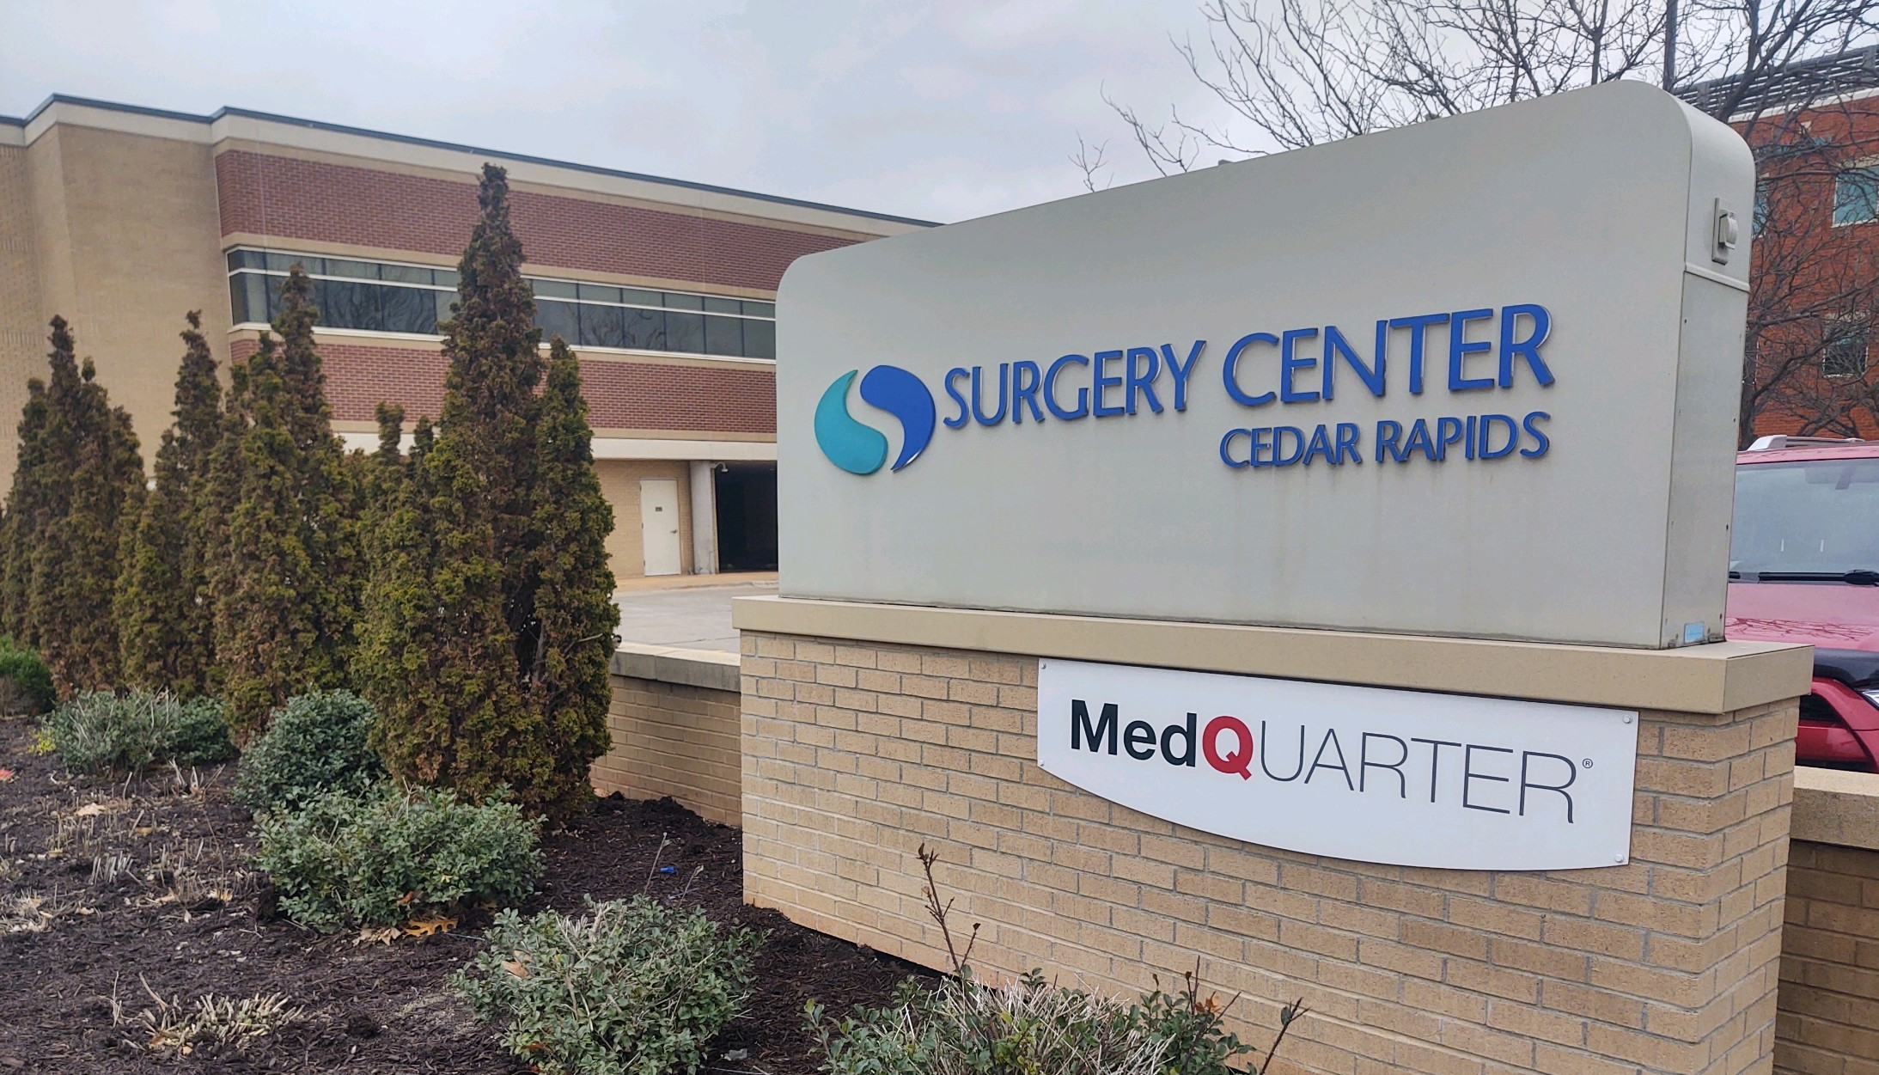
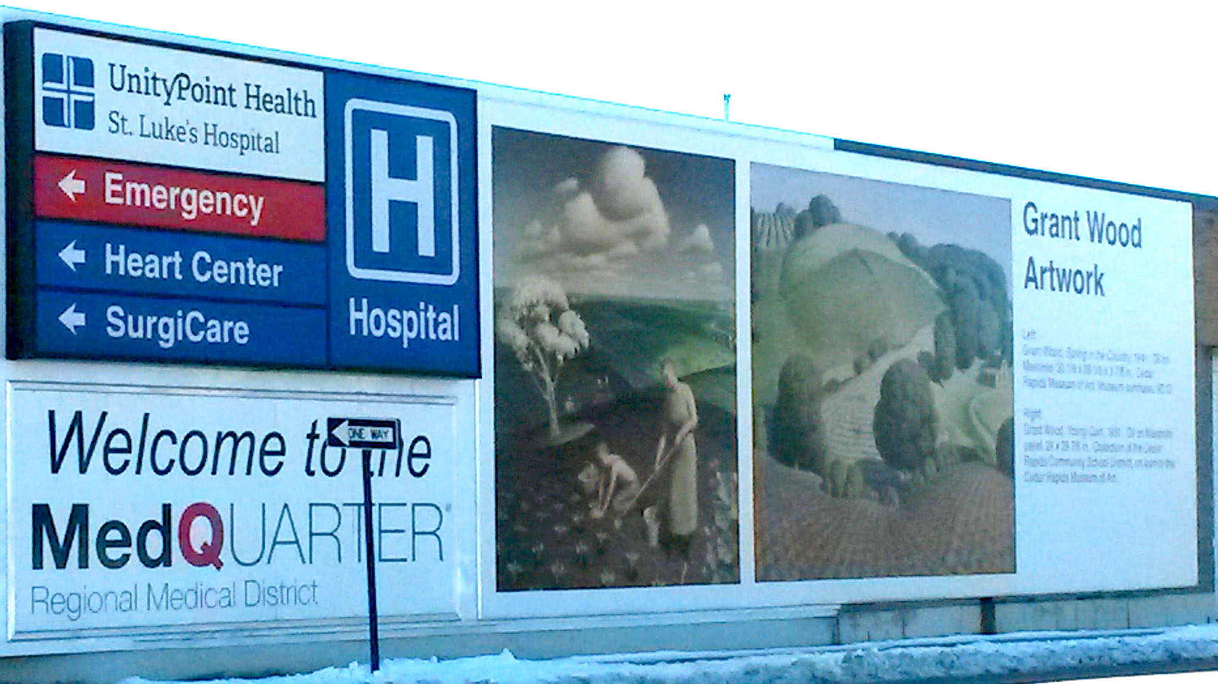
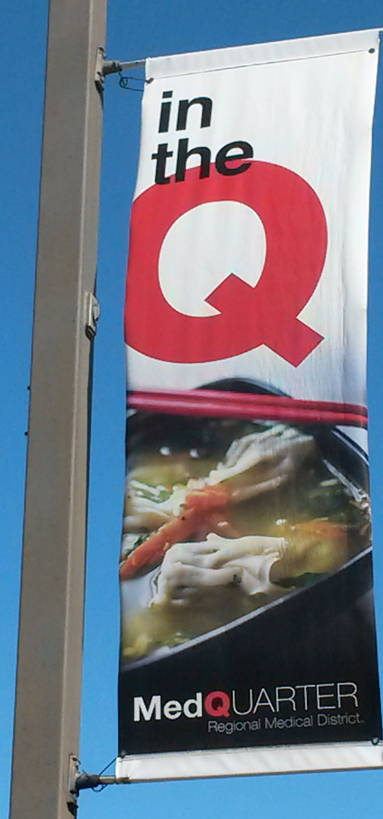
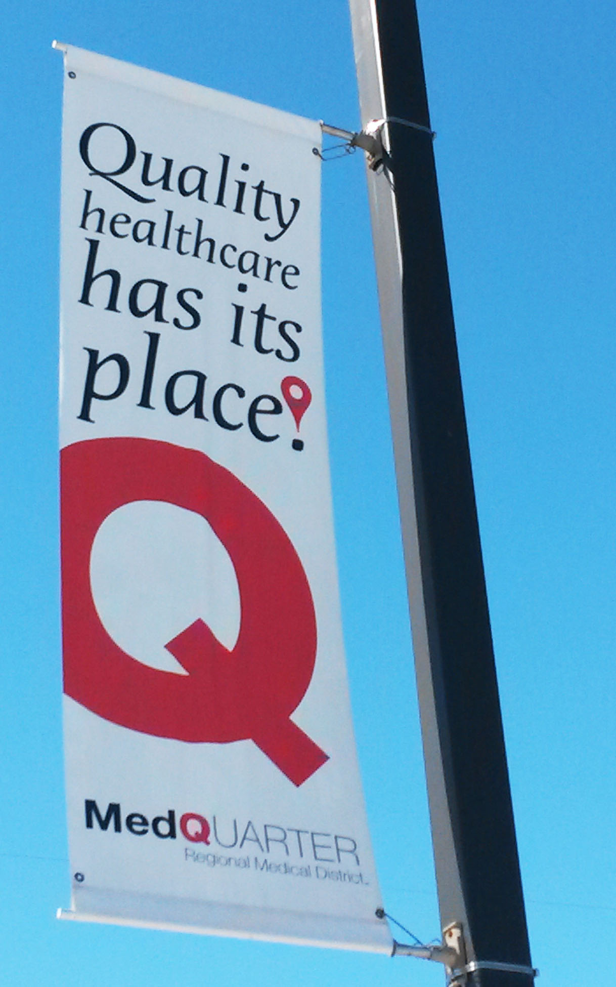
MedQuarter Appearance & Identity Initiatives

Slide 12
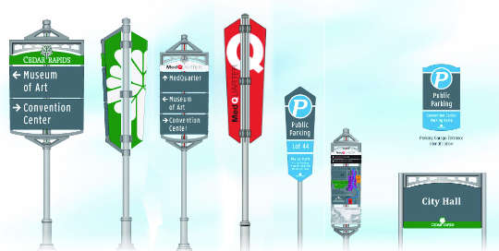
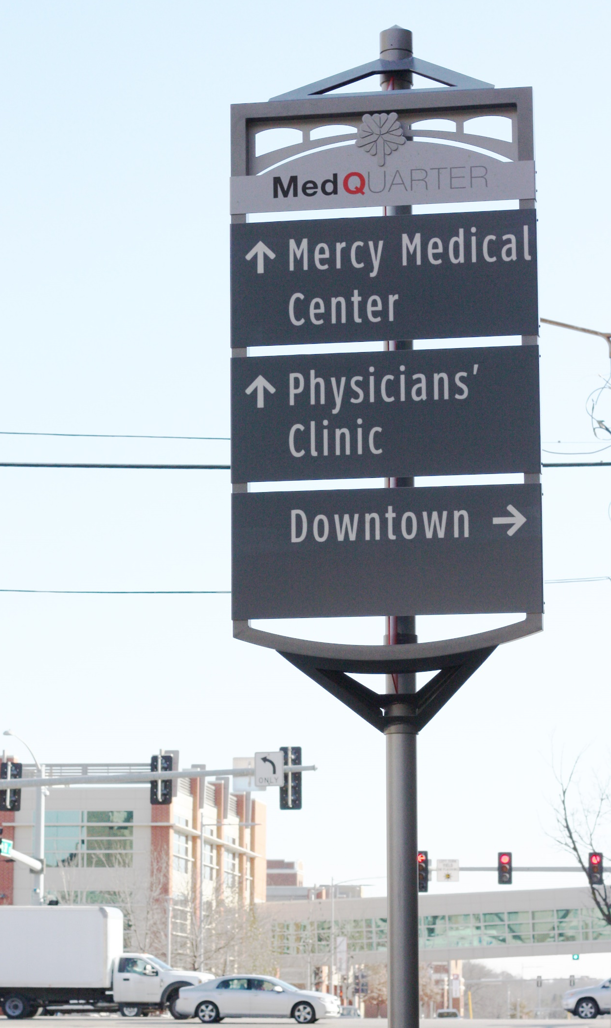
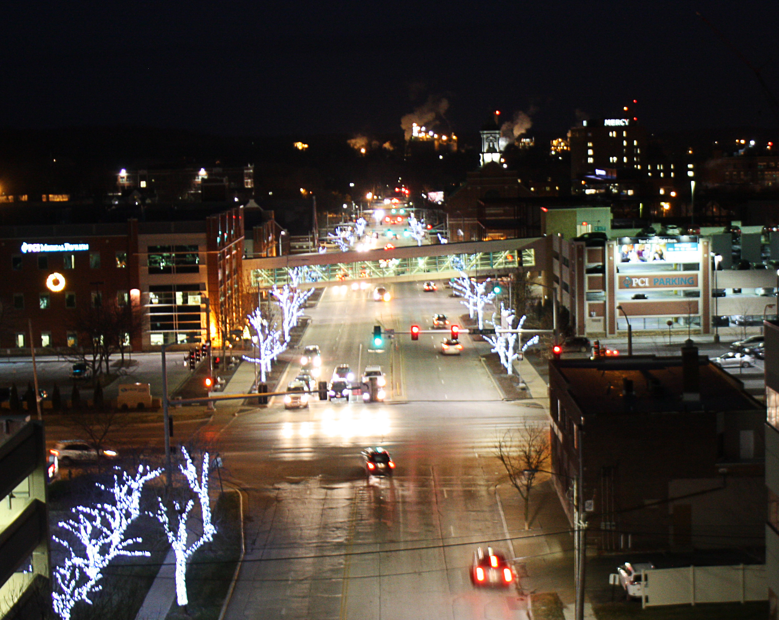
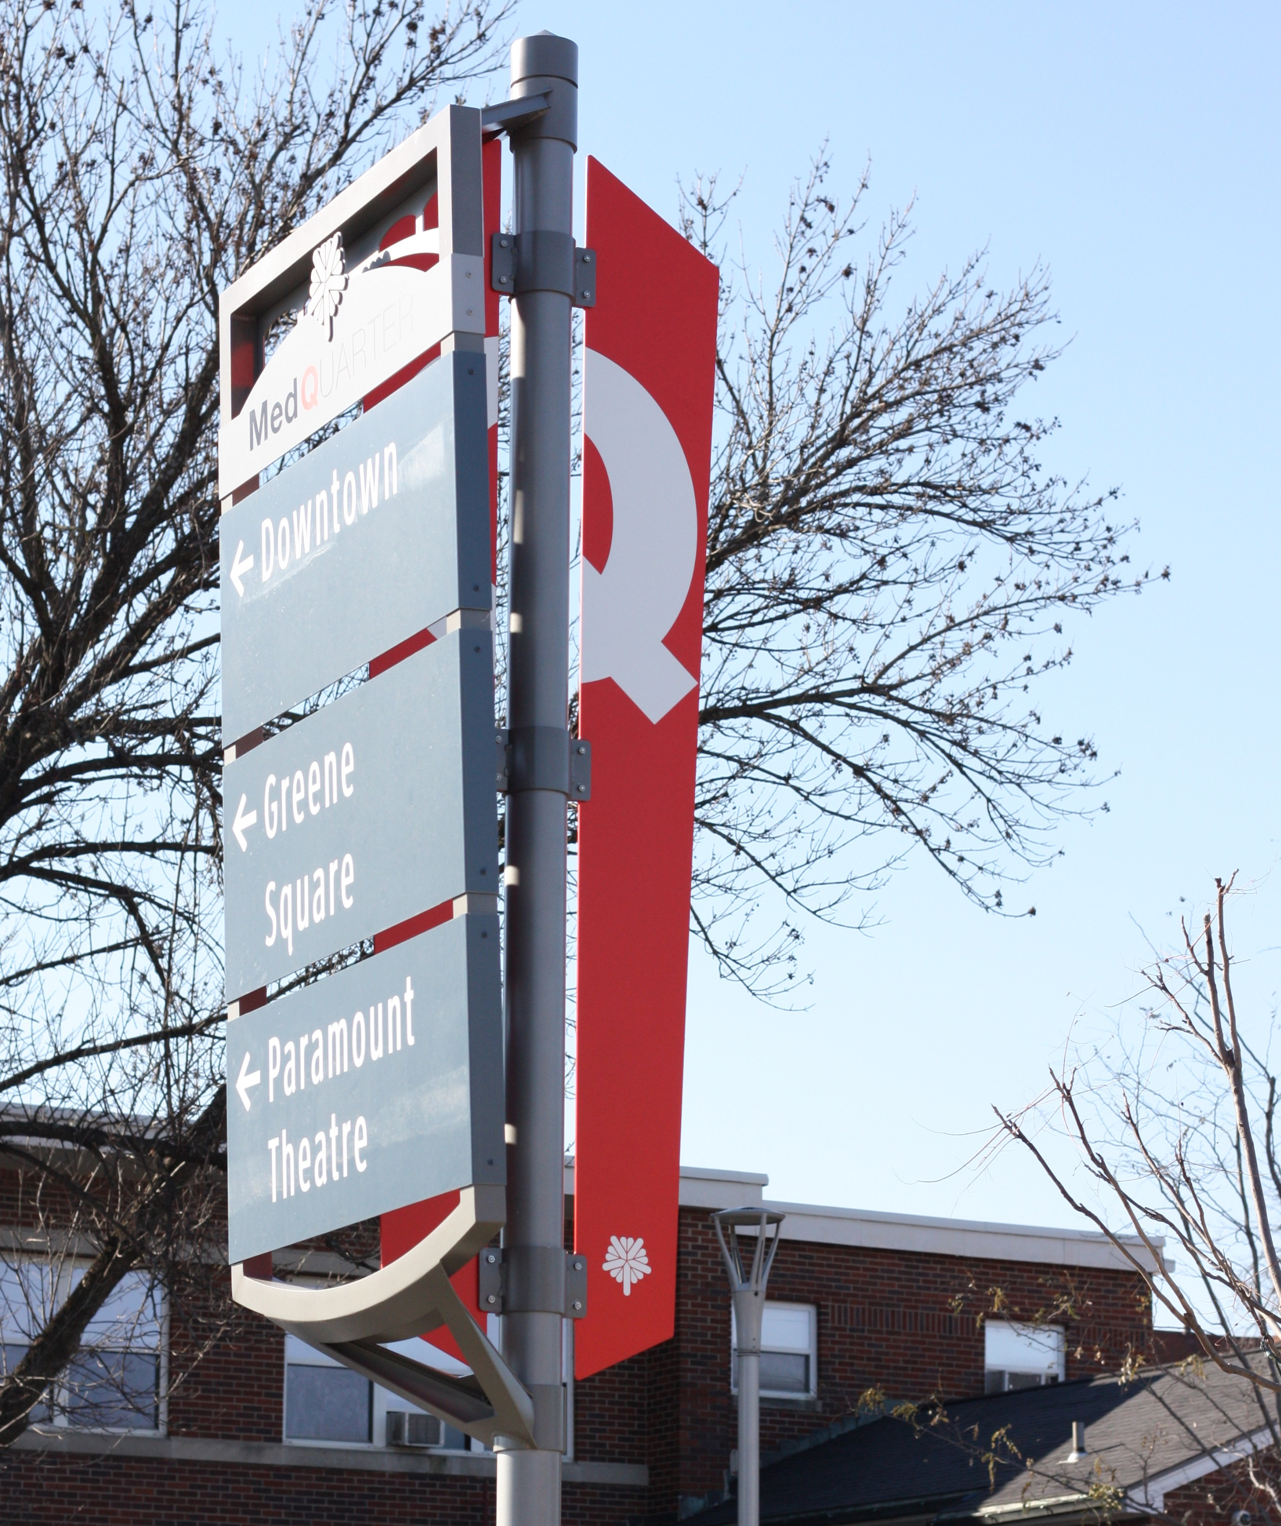
MedQuarter Appearance & Identity Initiatives
Wayfinding Signage
Holiday Lighting

Slide 13
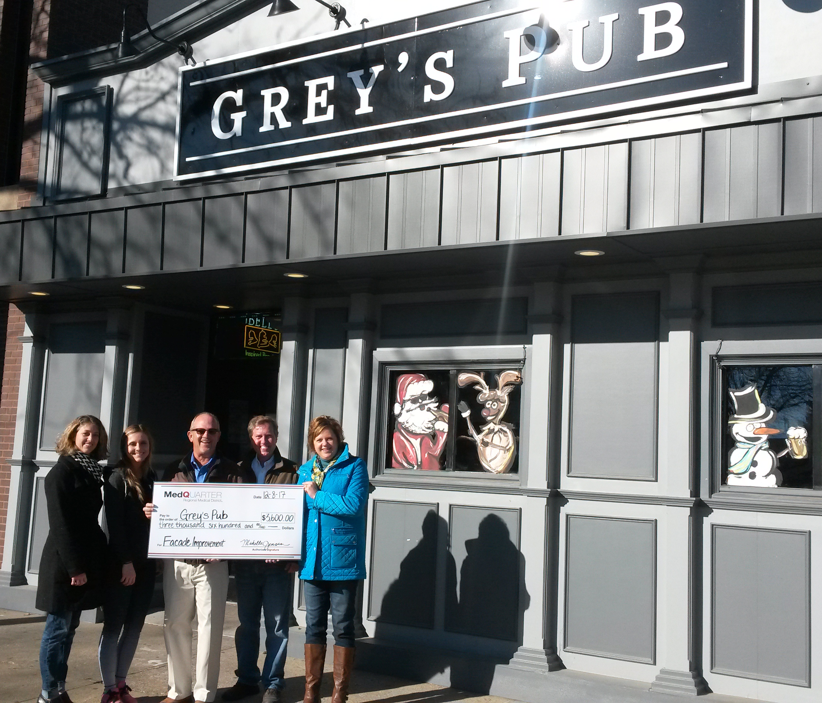
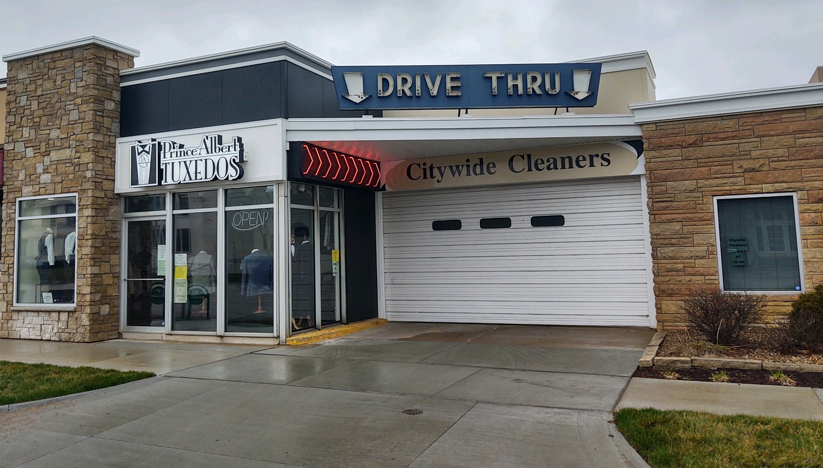
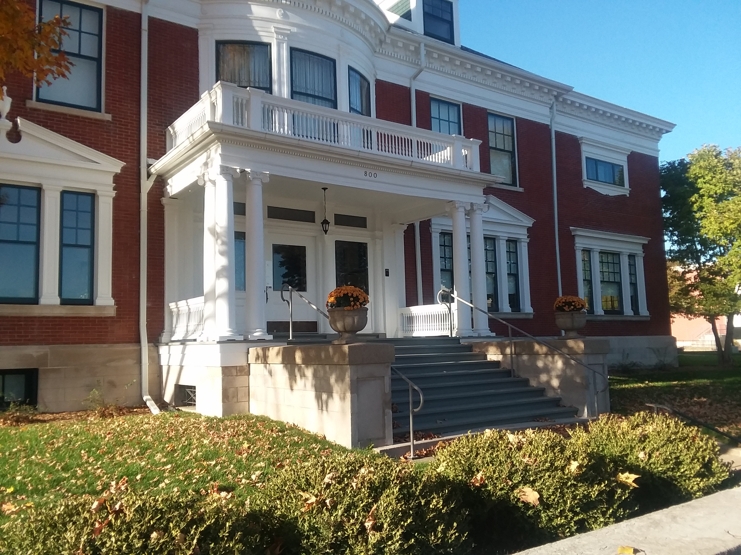
MedQuarter Appearance & Identity Initiatives
Façade Improvement Grant Program
The MedQ and City have awarded Façade Improvement Grants totaling $54,368. to date toward improvement projects worth over $1.1M throughout the District.

Slide 14
Access, Circulation & Infrastructure
2017 10th Street SE, 4th to 5th Street, $930K - $585K by City & $345K by SSMID
2019 10th Street SE, 5th to 8th Street, $2.4M - $1.45M by City & $950K by SSMID
2020 1st Avenue E, 6th to 10th Street, $1.9M - $1M by City & $900K by SSMID
2021 1st Avenue E, 10th to 12th Street, $650K - $490K by City & $160K by SSMID (Budgeted)

Slide 15
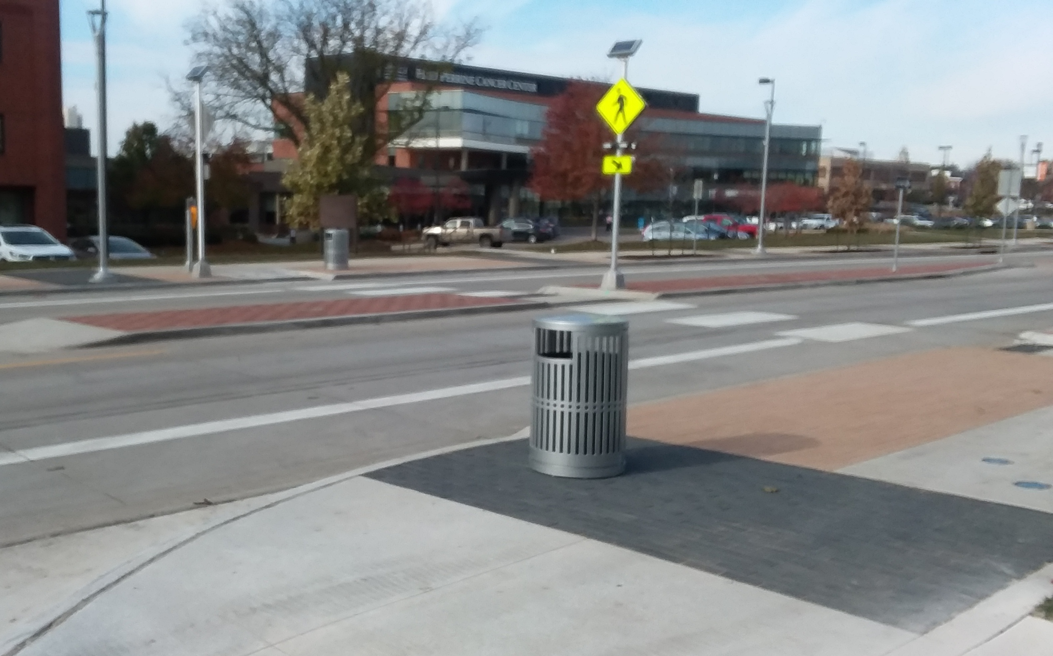
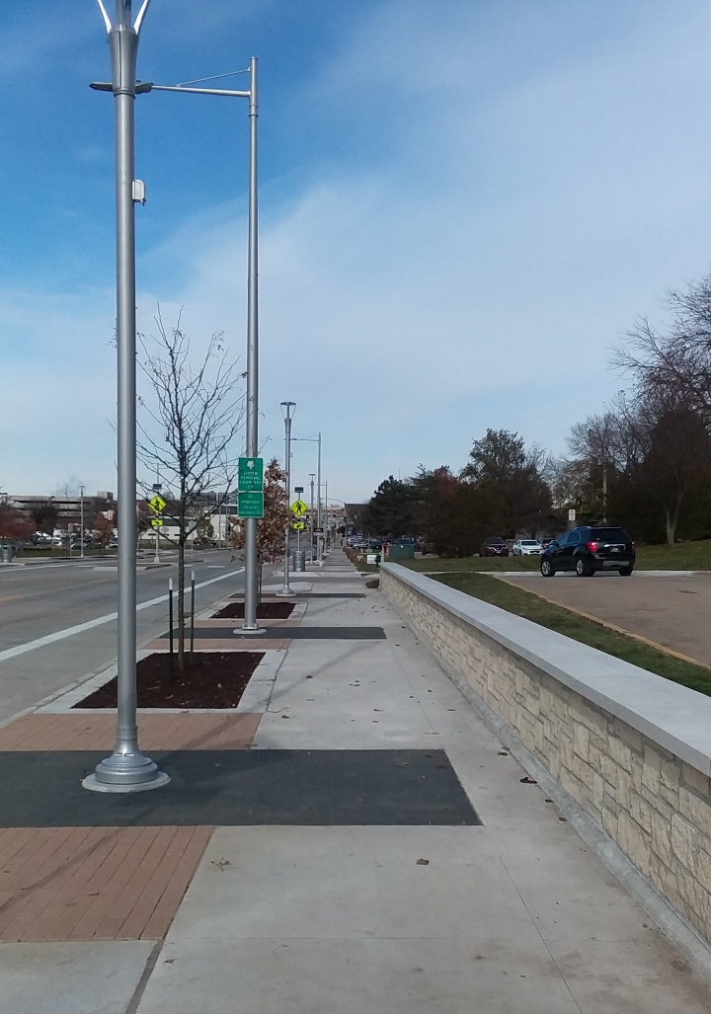
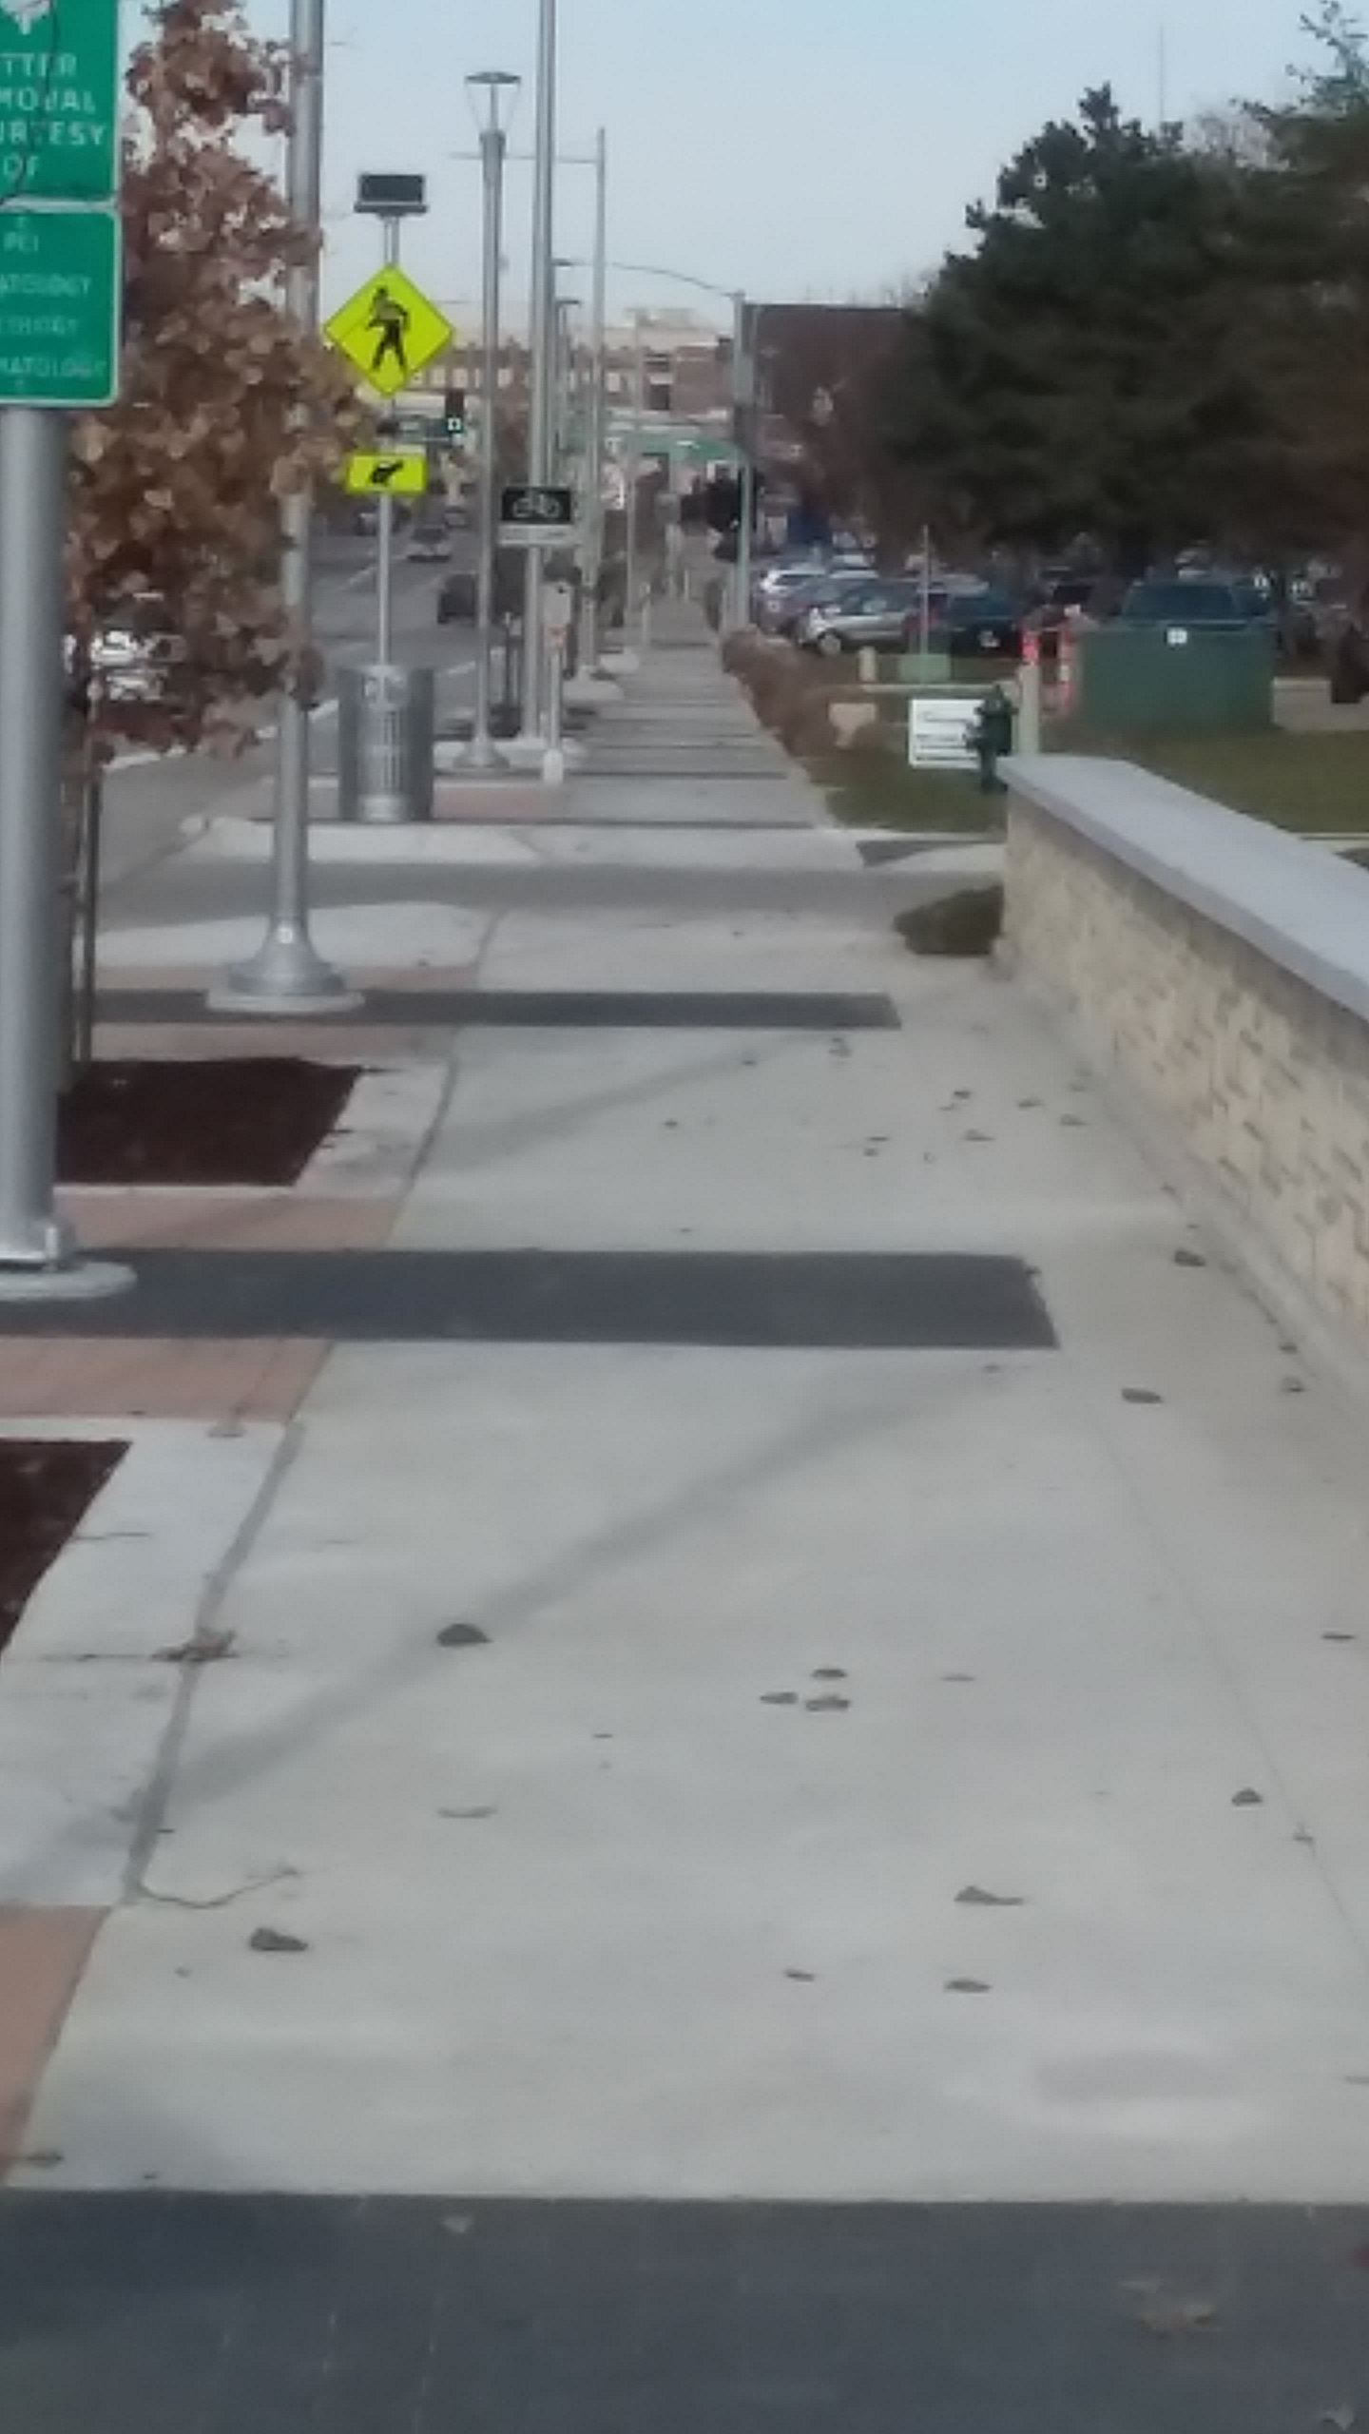
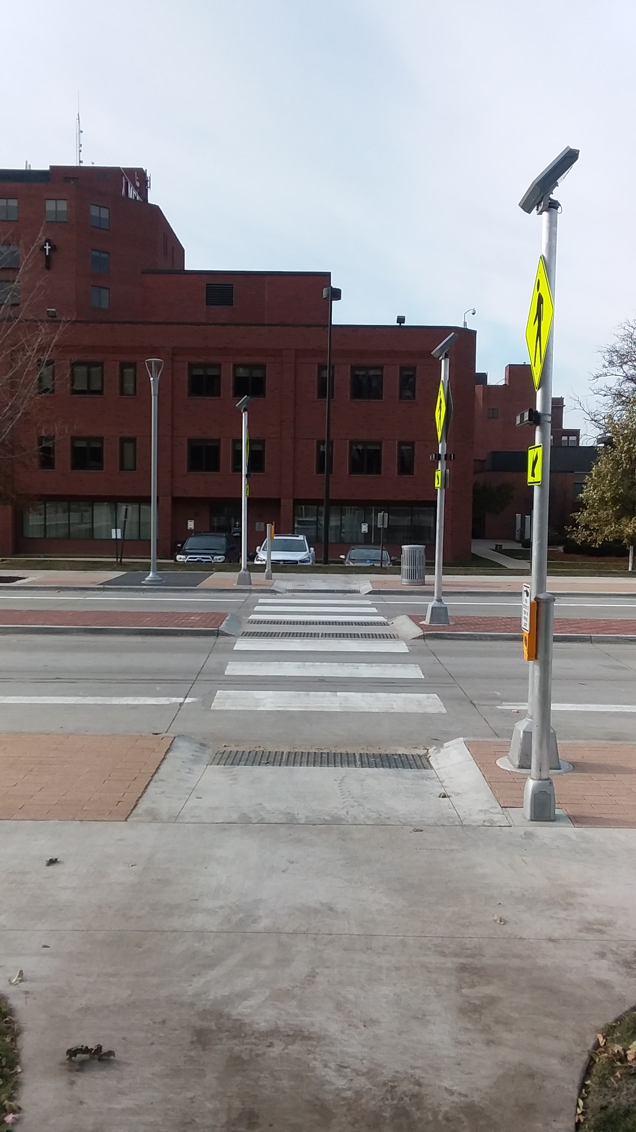
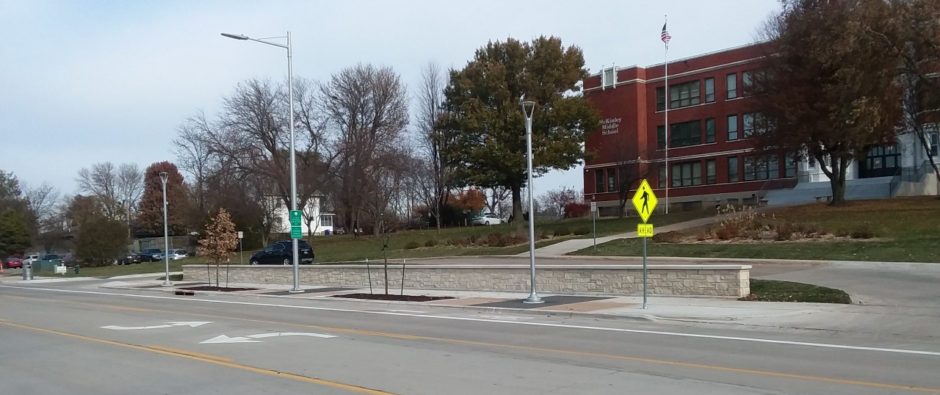
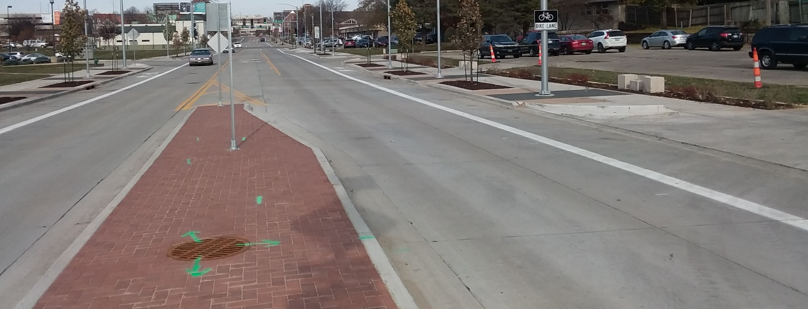
10th Street Improvements

Slide 16
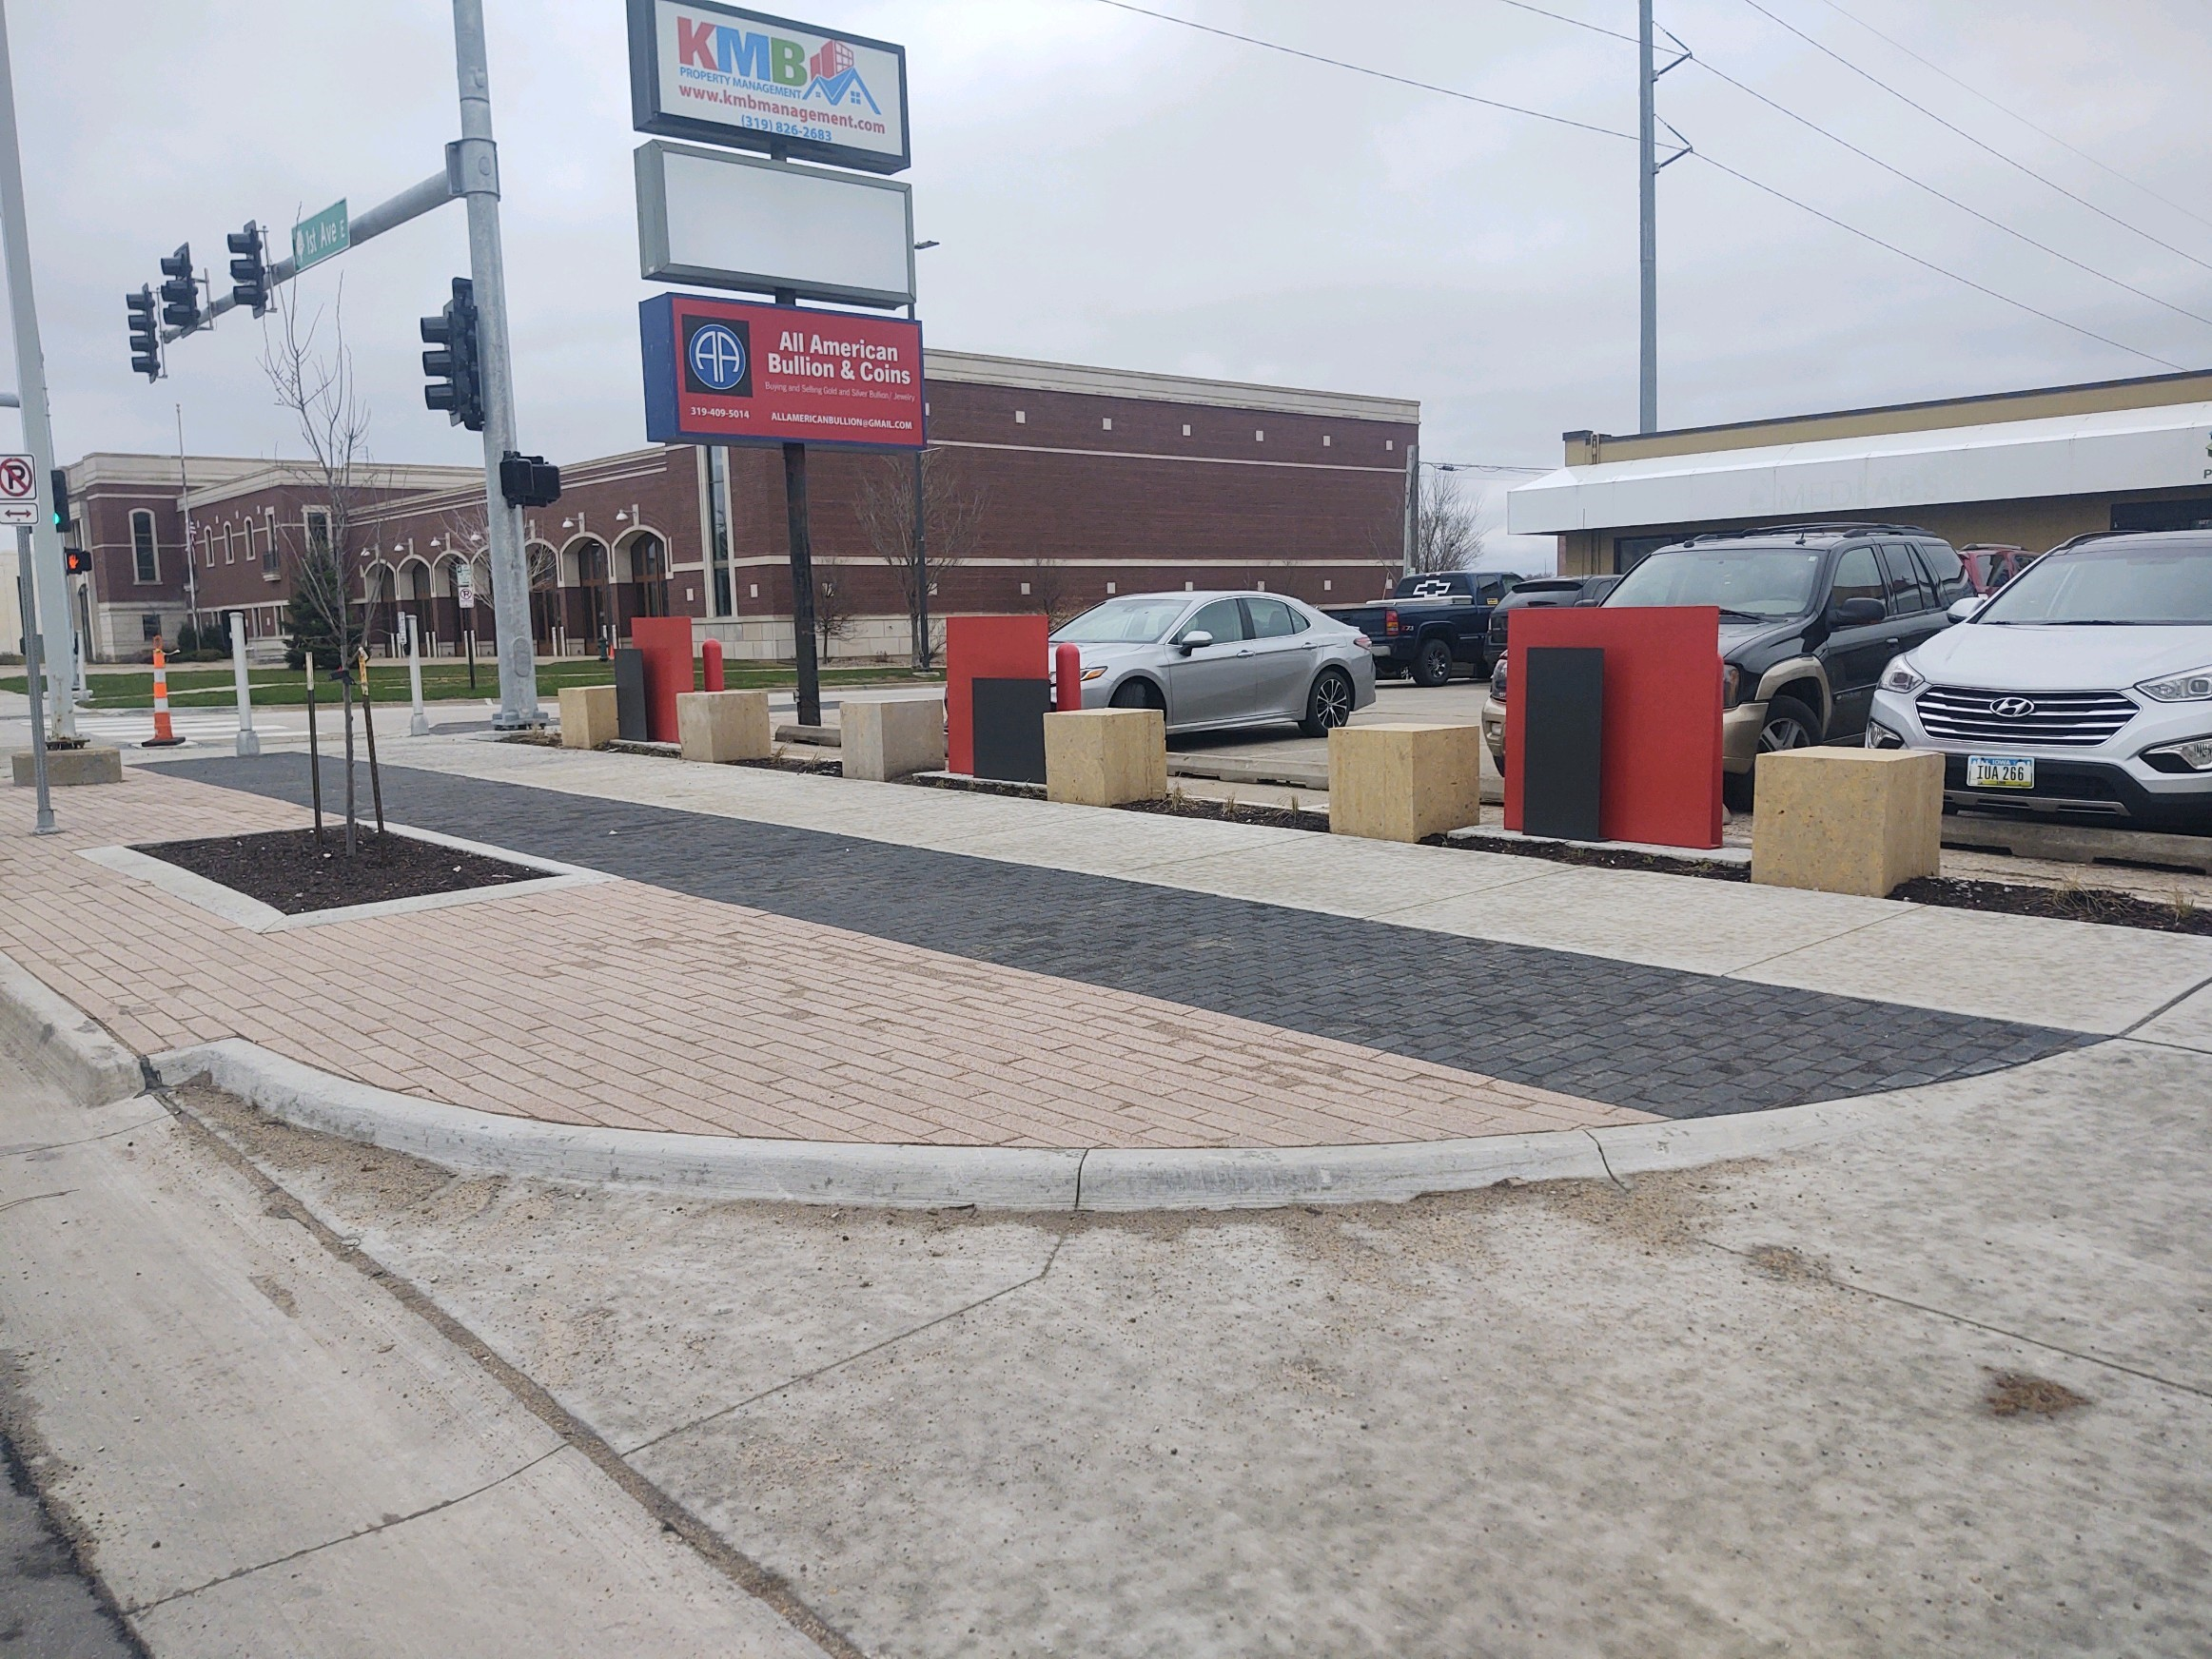
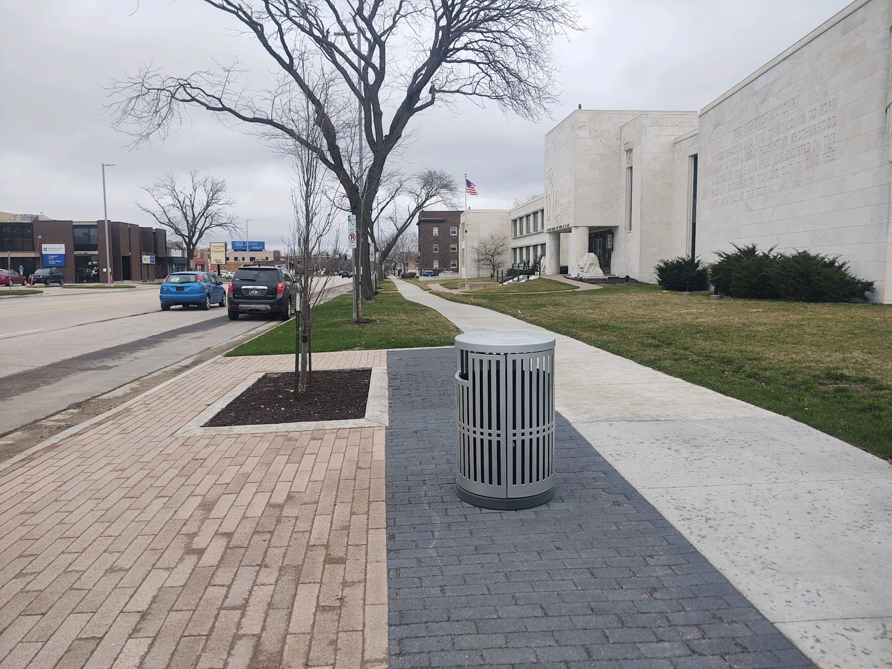
1st Avenue Improvements, 6th – 10th

Slide 17
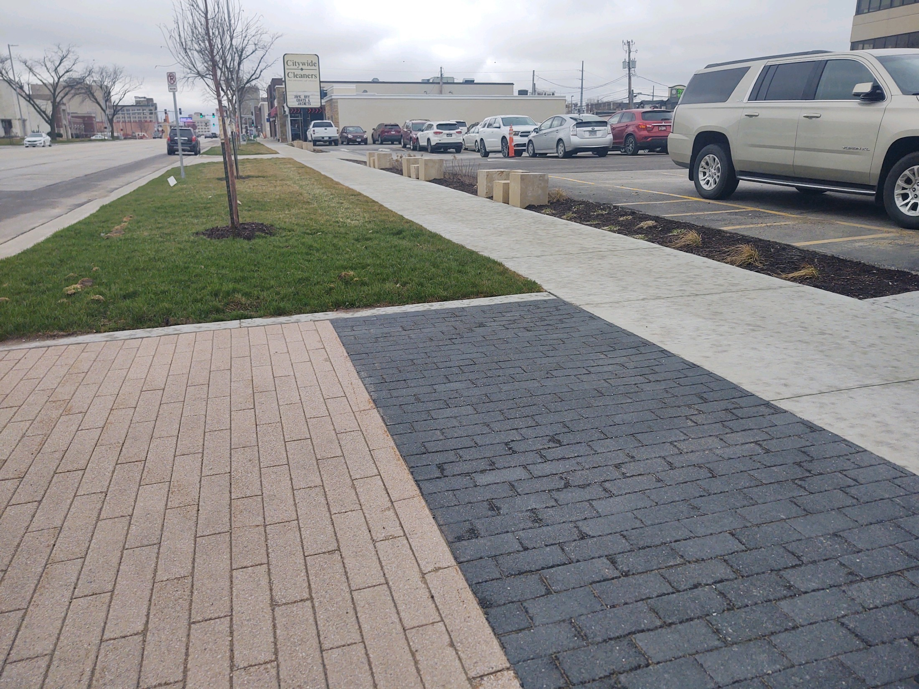
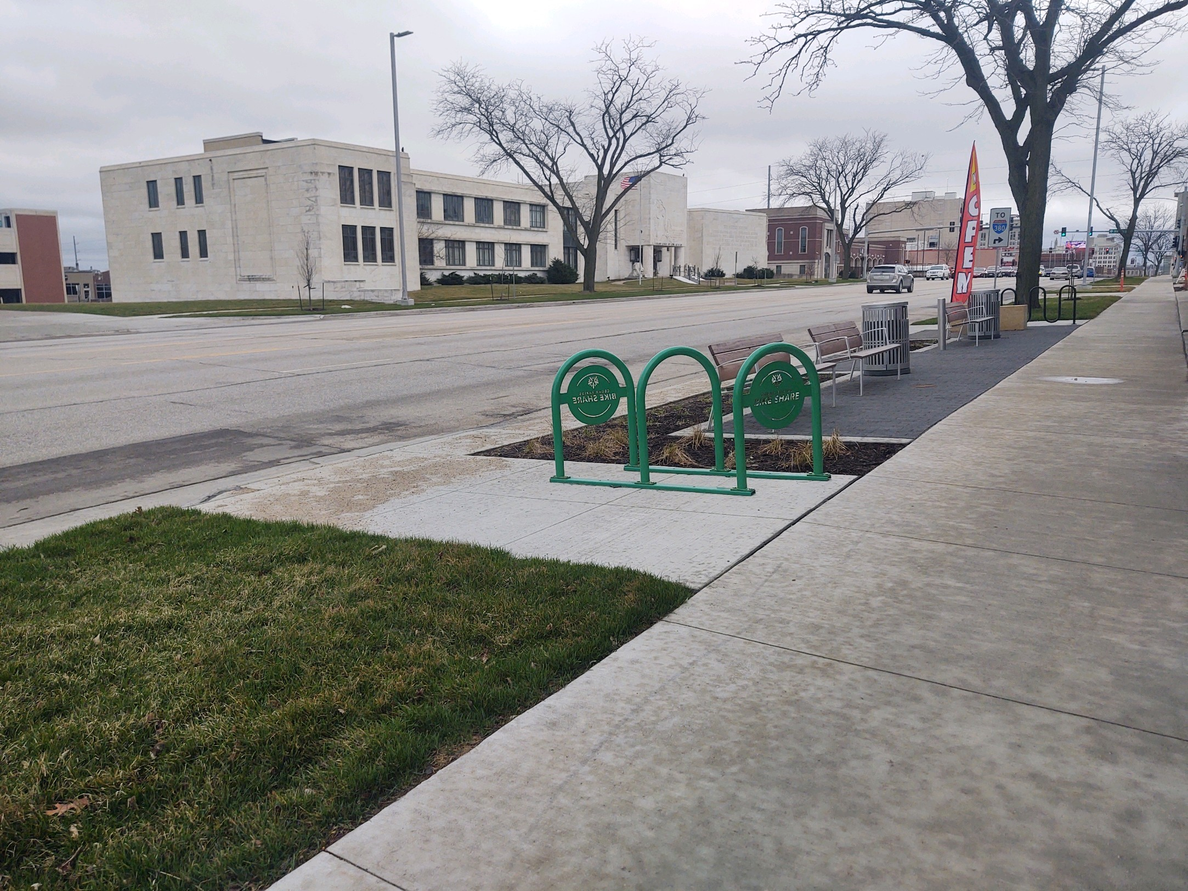
1st Avenue Improvements, 6th – 10th

Slide 18
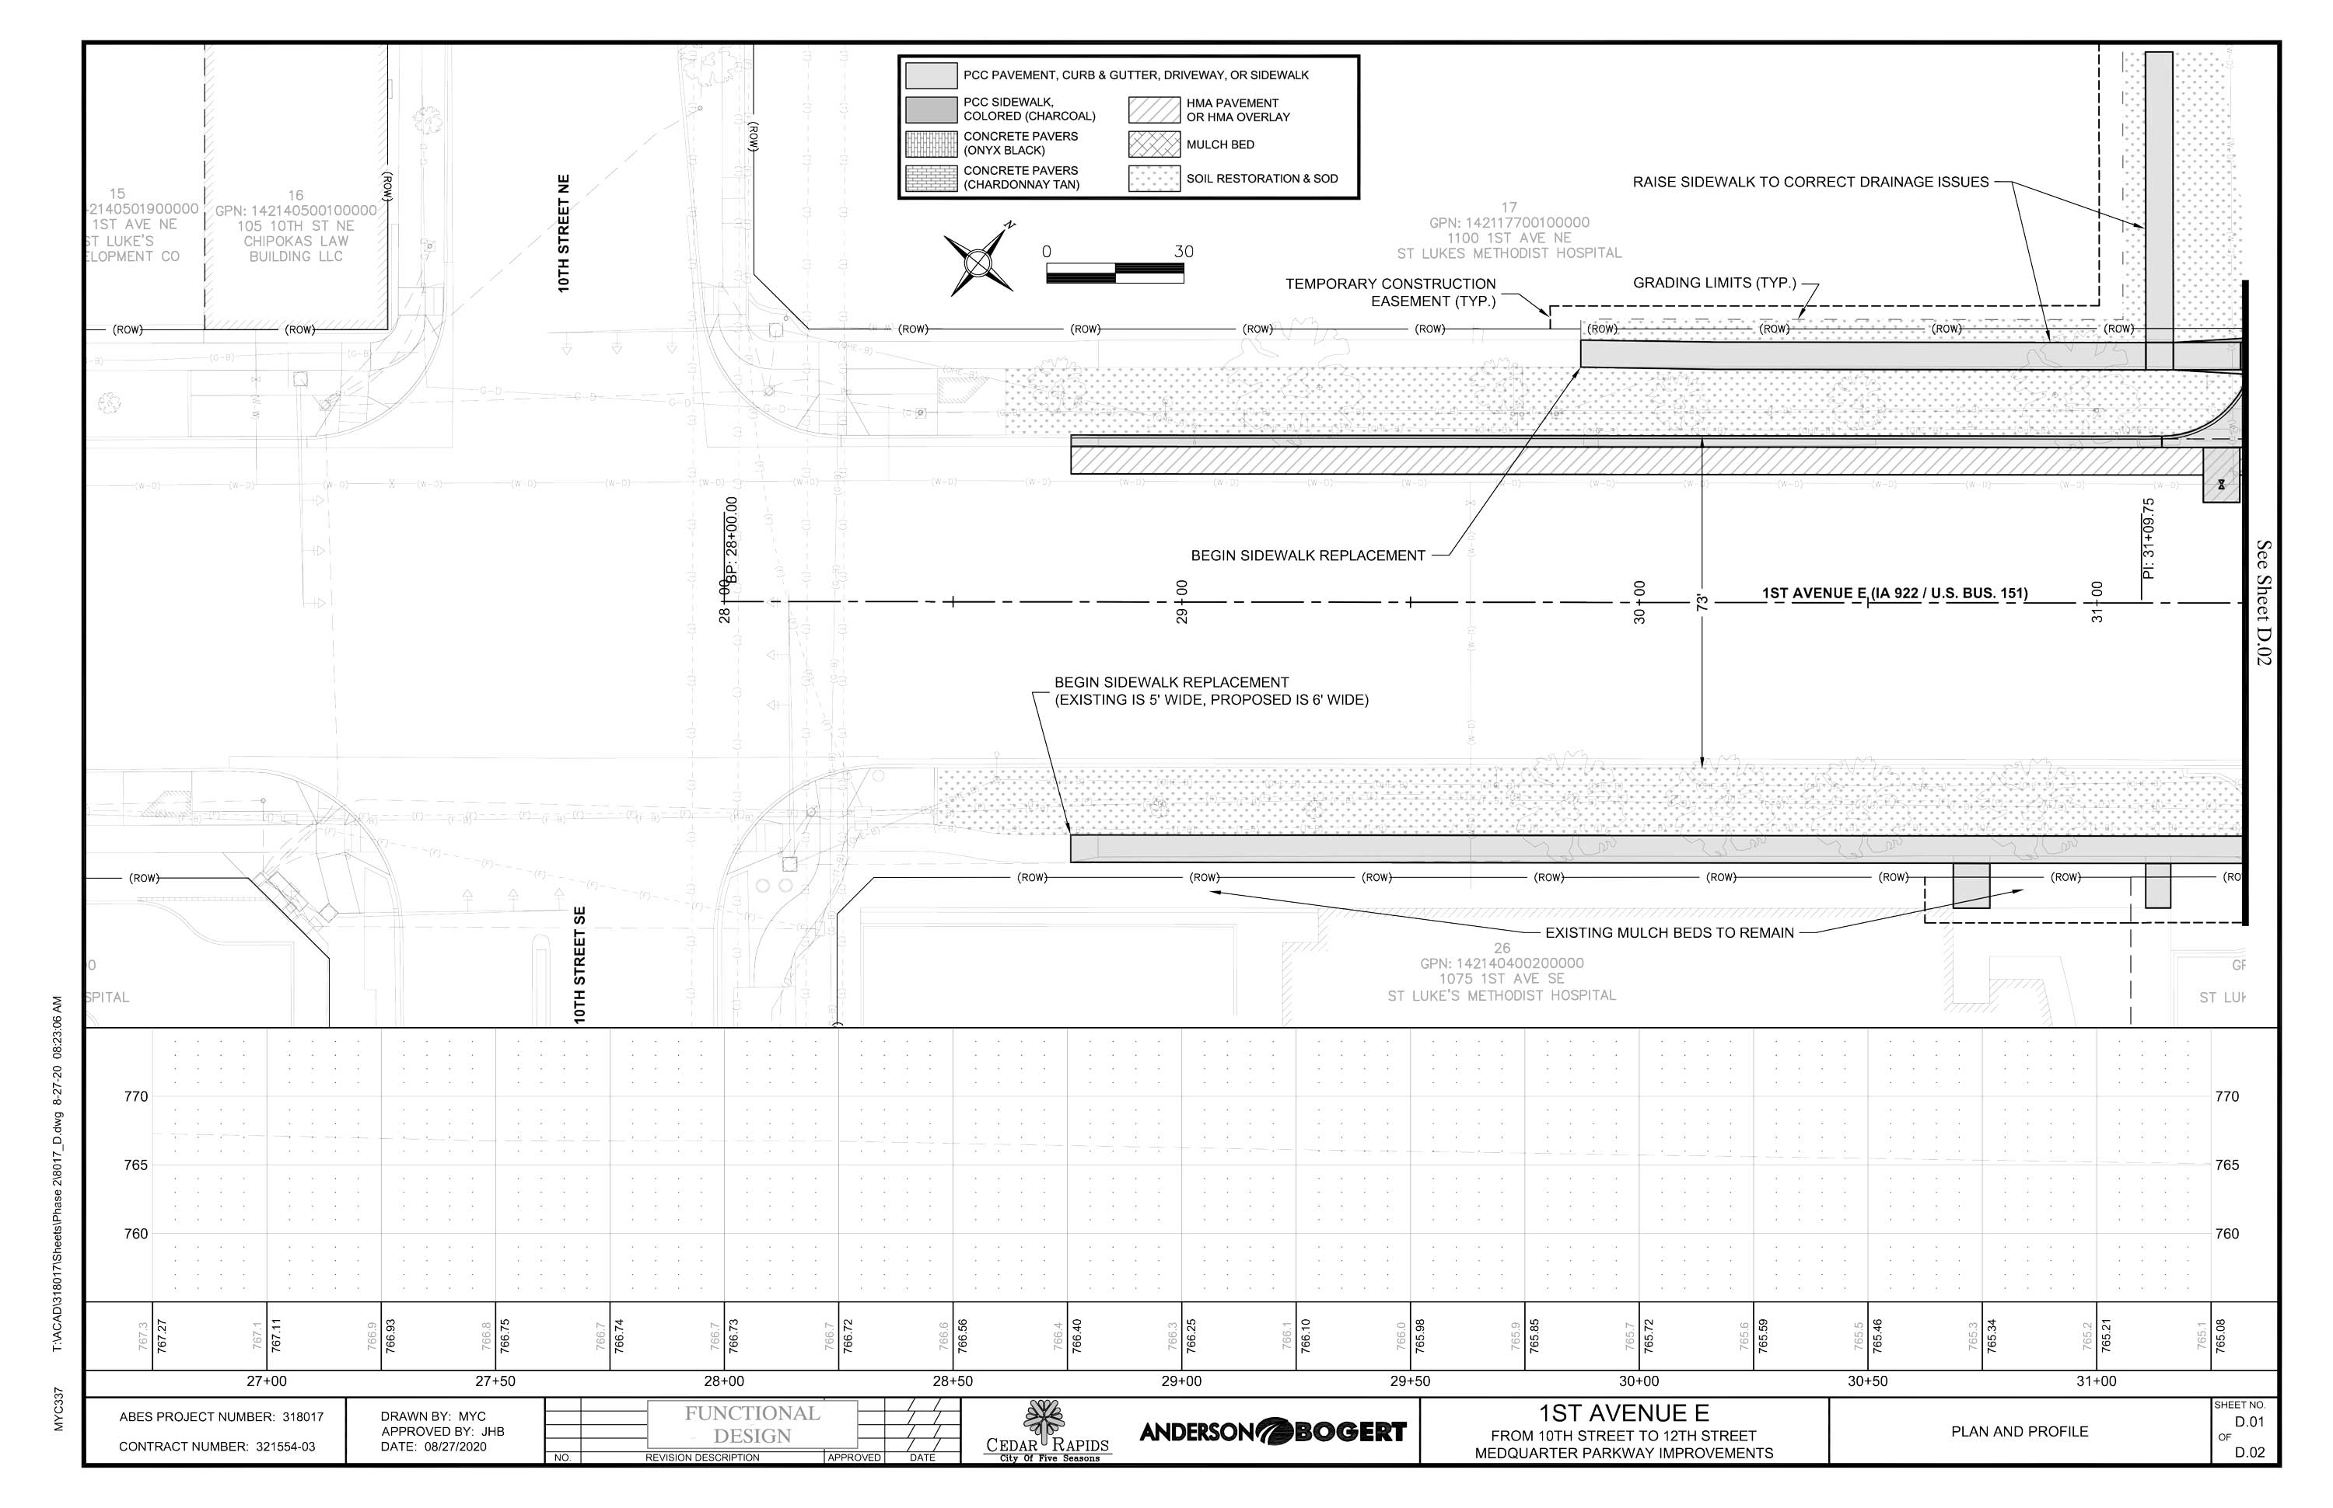
1st Avenue Improvements, 10th – 12th

Slide 19
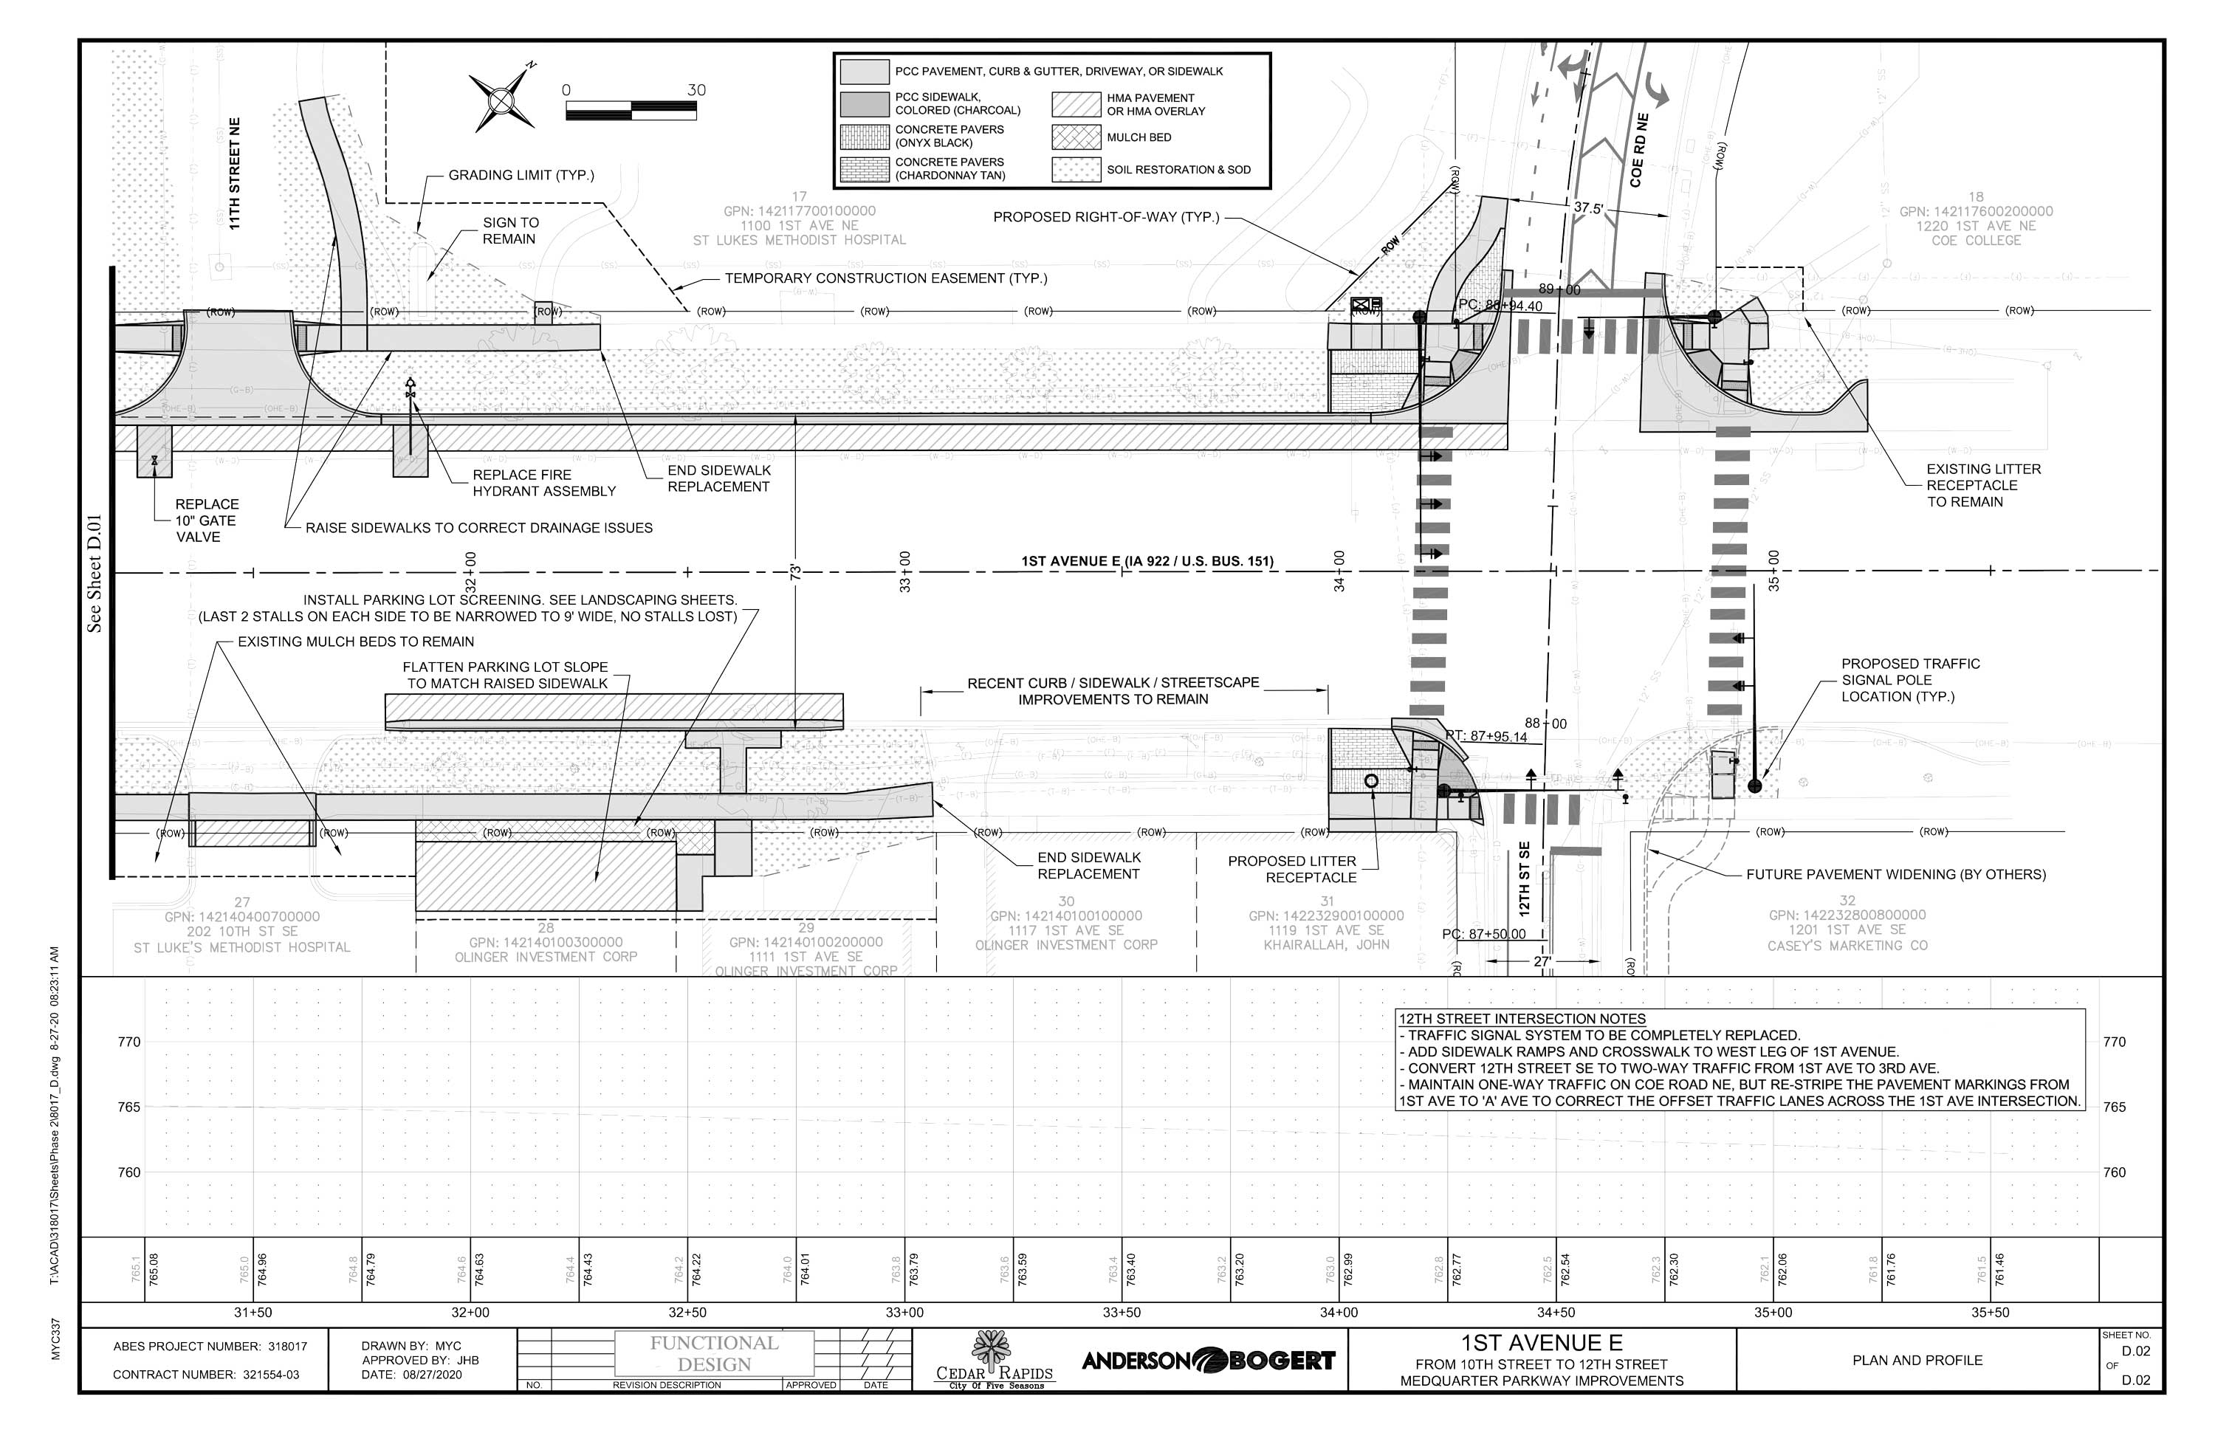
1st Avenue Improvements, 10th – 12th

Slide 20
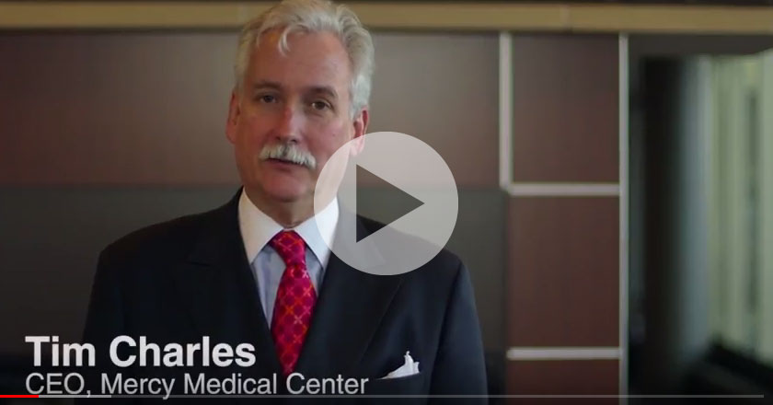
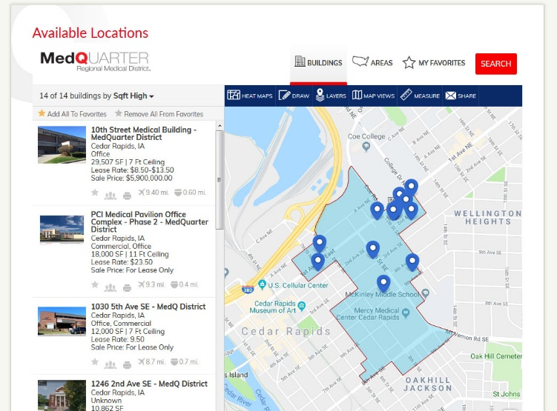
MedQuarter Economic Development Initiatives
MedQuarter Child Care
Feasibility Study &
Pro Forma Analysis
Revolving Loan Fund
Economic Development Video
LOIS Listings On Website

Slide 21
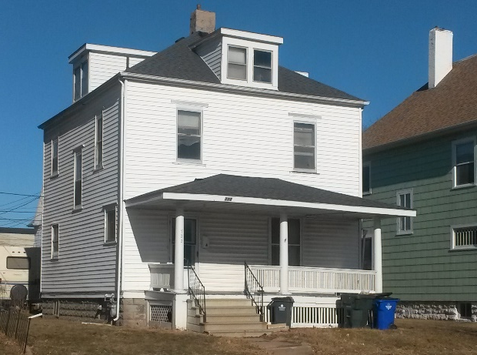
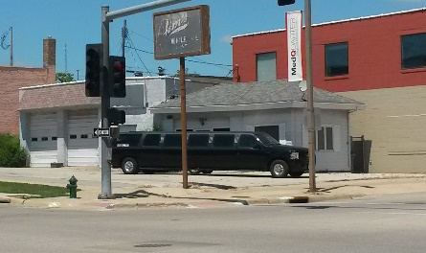
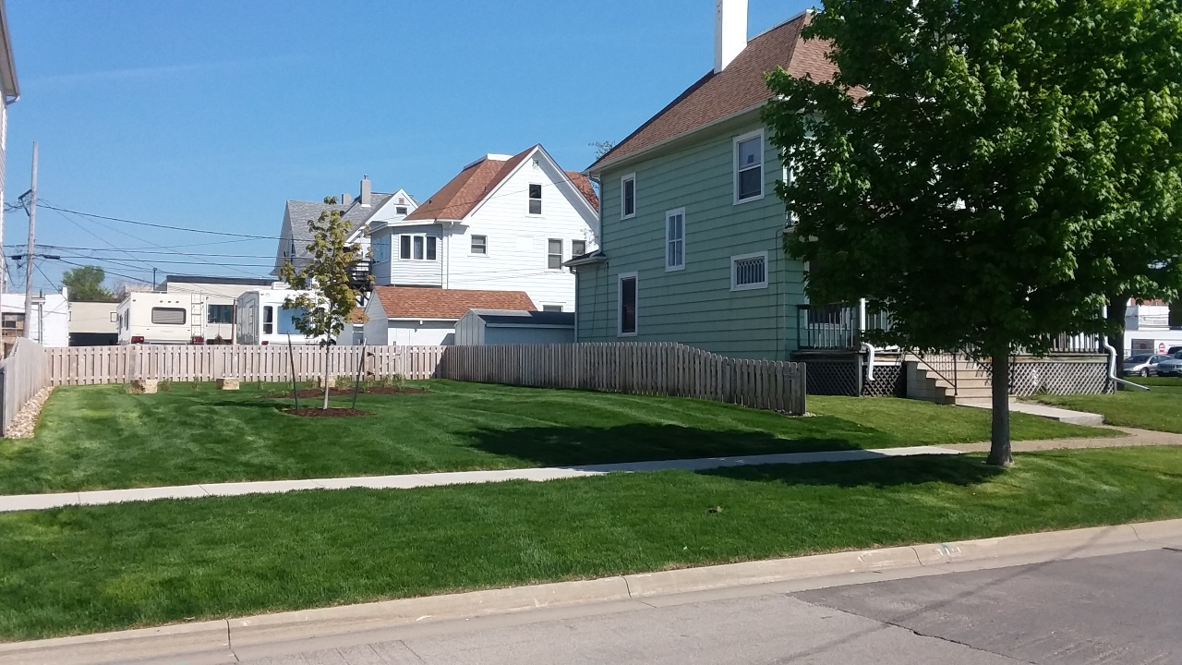
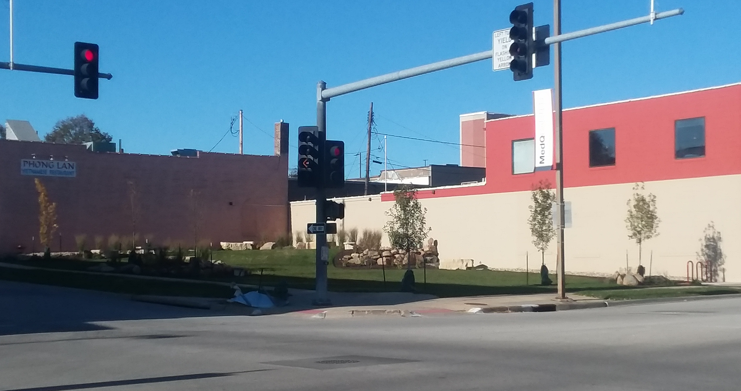
MedQuarter Economic Development Initiatives
Before
Before
After
After
722 4th Ave. SE
800 3rd Ave. SE

Slide 22
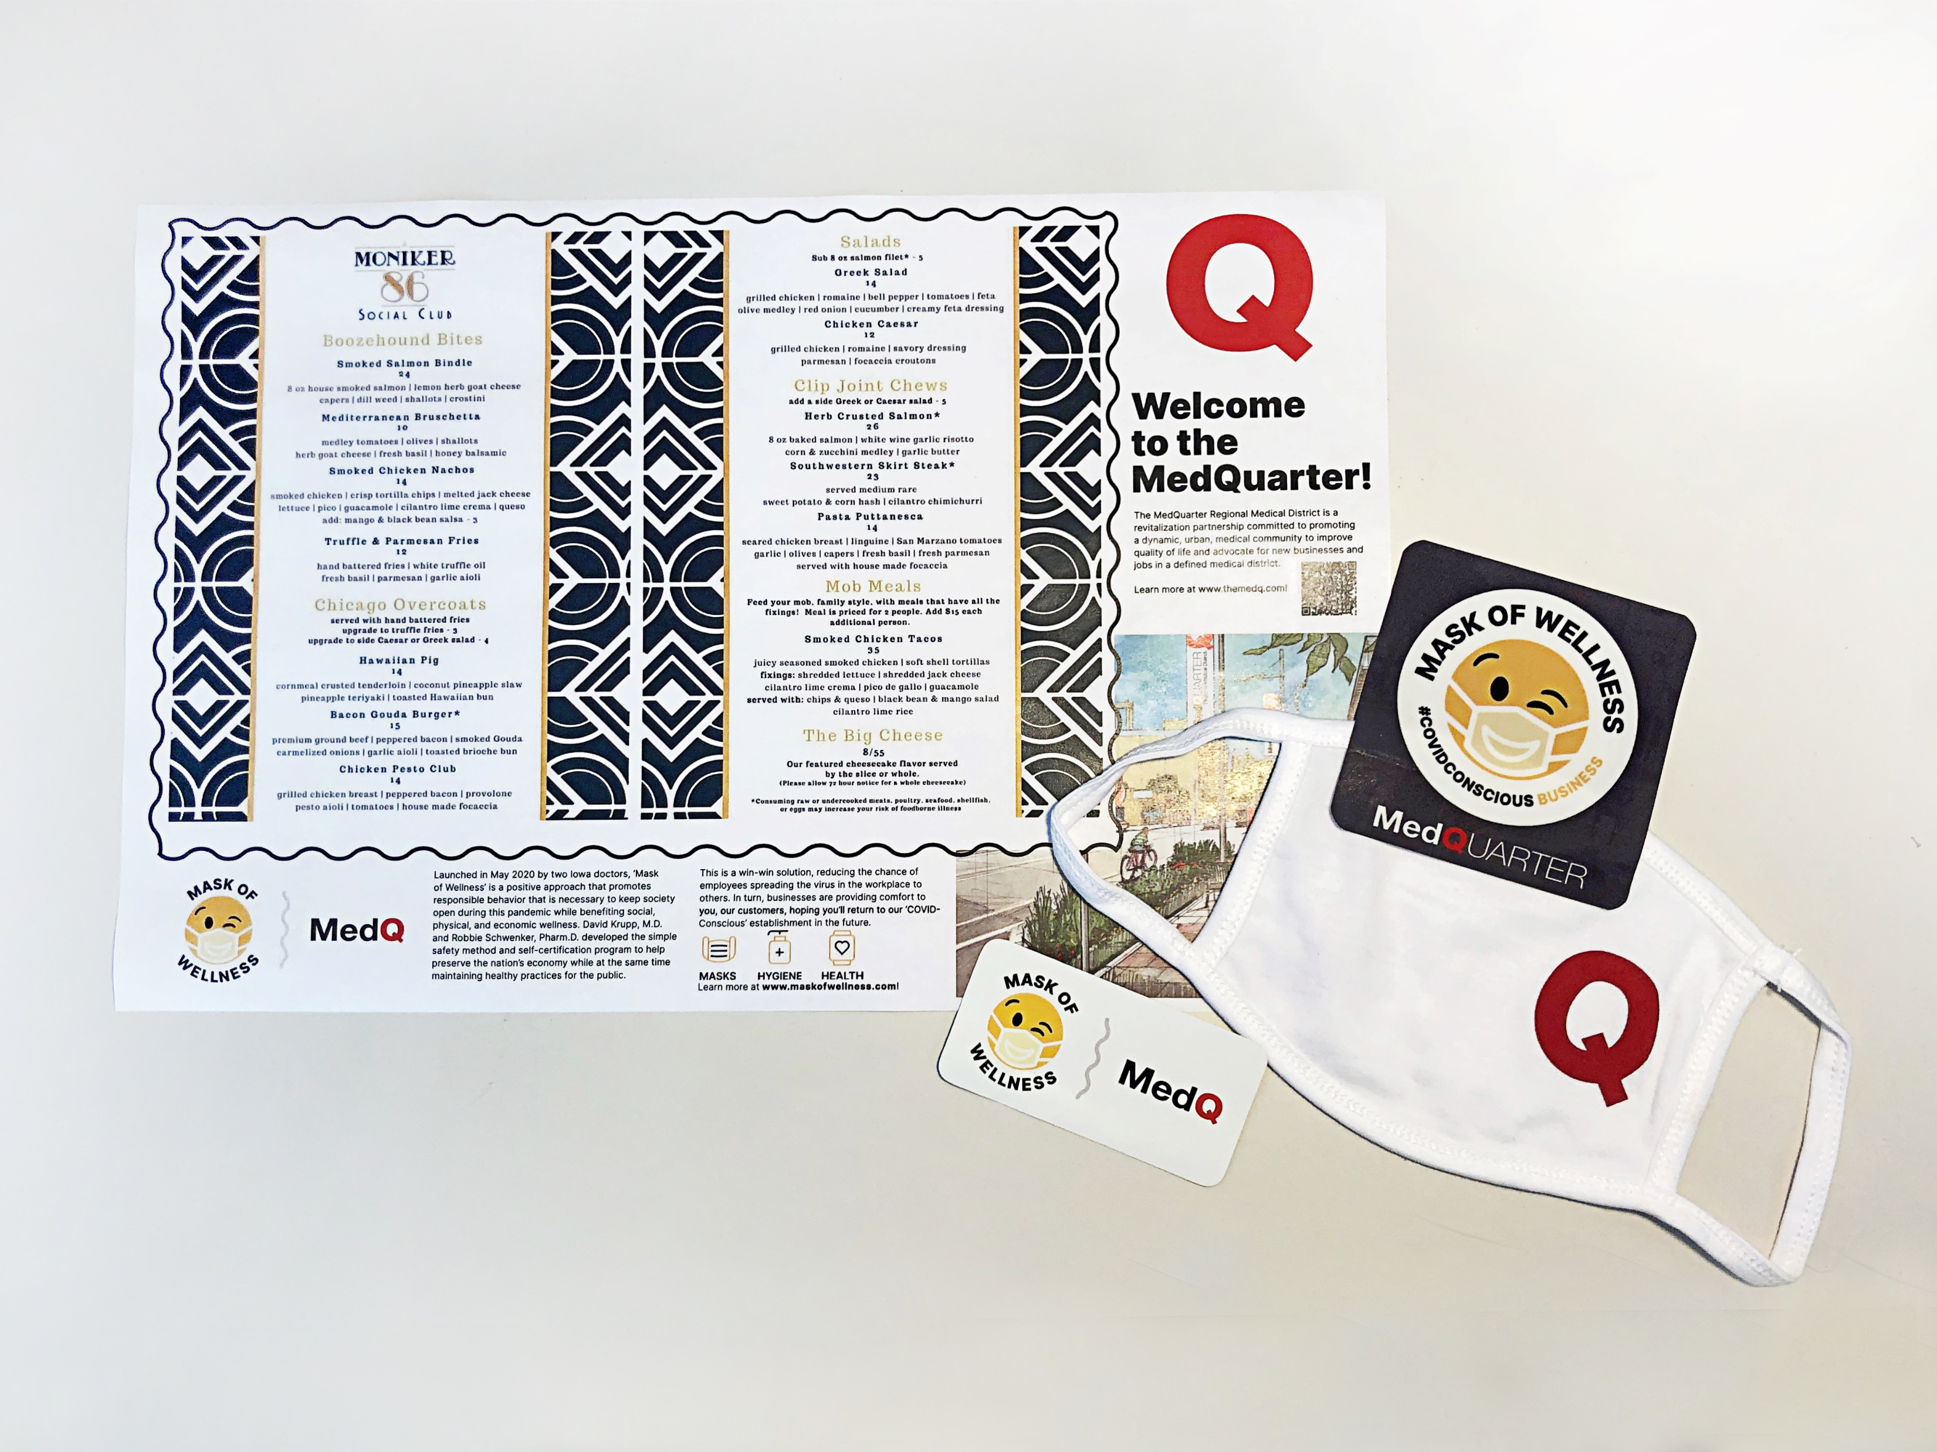
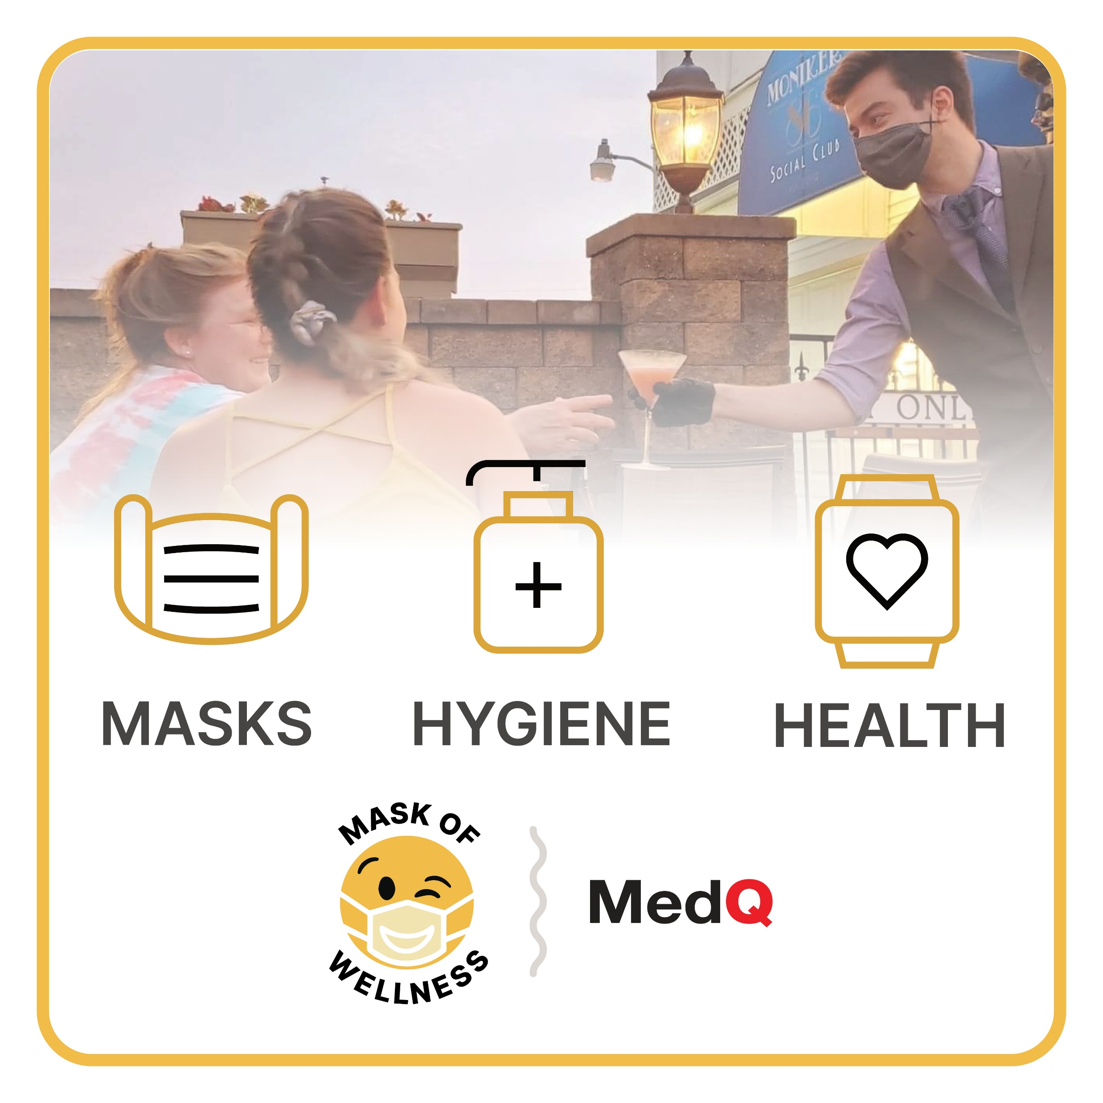
2020 Pandemic Response
PPE Sourcing
Mask of Wellness + MedQ
Energy Pack Distribution
Gifts of Gratitude
Meals To Go From the MedQ

Slide 23
2020 Derecho Response
Signage and wayfinding damage
Structural damage
2021 Stump removal with City of Cedar Rapids
Paulsen Building Damage
MedQ Wayfinding Sign Damage
Dental Equipment Building Damage

Slide 24
Accomplishments are being made
week in and week out,
both big and visible, and small and purposeful.
As with all organizations, the Medical SSMID had to pivot significantly in 2020 due to the pandemic. All events were cancelled. All meetings were conducted virtually. A focus on sharing information and consistent communications was adopted with targeting of health care, non- health care, for profit, non-profit, restaurant, retail, service and entertainment entities to assist wherever possible. That said, the District was able to complete our
2020 Parkway Improvement Project.
Our 2021 Action Strategies are in alignment with our Master Development Plan as well as the feedback gathered in our 2021 Stakeholder Survey. The improvements will benefit the collective District as a whole, not any one entity, per the direction of the SSMID Commission.

Slide 25
MedQuarter Regional Medical District Commission & Committees
Commission
John Albert, Jr., Citywide Cleaners
Timothy Charles, Mercy Medical Center
Gordon Epping, Gordon Epping, LLC
Michelle Jensen, CarePro Health Services
Suzy McGrane-Hop (Vice Chair), Gilded Pear Gallery
Mary Meisterling, Alliant Energy/IPL
Michelle Niermann, UnityPoint Health
Okpara Rice (Chair), Tanager Place
Karen Smith, Republic Abstract
Dr. Julie Sterling, Family Medicine Specialists, P.C.
Michael Sundall, Physicians’ Clinic of Iowa, P.C.
Dr. Sarah Wickenkamp, University of Iowa – Pediatrics
Staff
Phil Wasta, Executive Director
City Liaison
Sandi Fowler, Deputy City Manager
Committees
Branding & Marketing
Economic Development
Finance & Operations
Standards
Sub-Committees
Design Review Committee
Façade Improvement Grant Committee
MedQuarter Faith & Medicine Task Force
MedQuarter Mural Review Committee

Slide 26
Questions?
www.themedq.com

